Slide 1
COLOSSIANS CHAPTER 2
10/2/2022
1

Slide 2
SUMMARY
Chapter 2 deals with Paul's rejection of false doctrine. This chapter also exposes the nature of the false teachings Paul was refuting.
10/2/2022
2

Slide 3
COLOSSIANS 2:1-7 THE APOSTLE OF CHRIST PAUL'S SOLICITUDE
2.1 For I would that ye knew what great conflict I have for you, and for them at Laodicea, and for as many as have not seen my face in the flesh;
Paul is talking about an inner conflict he has for the people of Colosse and the love he has for them. His desire was to actually meet and see them. And though he had not seen them, he is greatly concerned for them.
10/2/2022
3

Slide 4
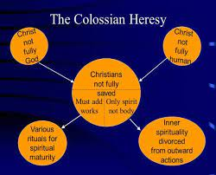
COLOSSIANS 2:1-7 THE APOSTLE OF CHRIST PAUL'S SOLICITUDE (Cond’t)
2.2 That their hearts might be comforted, being knit together in love, and unto all riches of the full assurance of understanding, to the acknowledgement of the mystery of God, and of the Father, and of Christ;
Paul's is concerned because of heresies that were spreading like a plague through the church. Now, one of the heresies that was being
10/2/2022
4

Slide 5
COLOSSIANS 2:1-7 THE APOSTLE OF CHRIST PAUL'S SOLICITUDE (Cond’t)
circulated in Colosse was the Gnostic heresy. The word Gnostic means “to know”. The Gnostics pretended they had a higher knowledge of mysterious things. Paul’s desire was that they might come to the acknowledgement of the mystery of God. He also desired their hearts be comforted and knitted together in love.
10/2/2022
5

Slide 6
COLOSSIANS 2:1-7 THE APOSTLE OF CHRIST PAUL'S SOLICITUDE (Cond’t)
2.3 In whom are hid all the treasures of wisdom and knowledge.
After mentioning mystery in the previous verse, Paul notes that Christ is the one "in whom are hidden all the treasures of wisdom and knowledge." Treasures are often hidden for the sake of keeping them safe. In this case, knowledge and wisdom are hid in Christ, but
10/2/2022
6

Slide 7
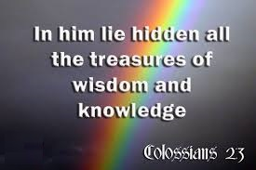
COLOSSIANS 2:1-7 THE APOSTLE OF CHRIST PAUL'S SOLICITUDE (Cond’t)
made available to those who believe in Him.
10/2/2022
7

Slide 8
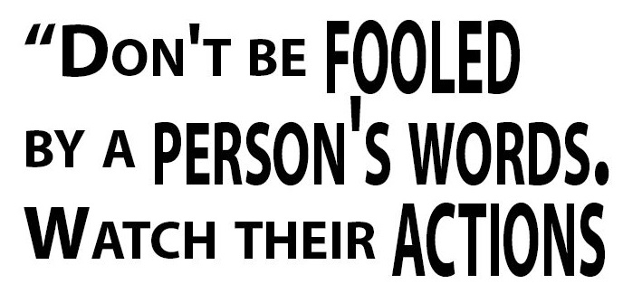
COLOSSIANS 2:1-7 THE APOSTLE OF CHRIST PAUL'S SOLICITUDE (Cond’t)
2.4 And this I say, lest any man should beguile you with enticing words.
Paul encourages the Colossian believers not to be fooled by arguments from non-believers. Human arguments may appear wise, but they are foolish in comparison to God's wisdom.
10/2/2022
8

Slide 9
COLOSSIANS 2:1-7 THE APOSTLE OF CHRIST PAUL'S SOLICITUDE (Cond’t)
2.5 For though I be absent in the flesh, yet am I with you in the spirit, joying and beholding your order, and the stedfastness of your faith in Christ.
As in verse 1, Paul notes he is not physically with the Colossian Christians, but is still closely connected to them. The spiritual connection is ultimately more important than any physical concerns. From a distance, Paul was happy to see the Colossians' strong, confident faith. These believers were focused
10/2/2022
9

Slide 10
COLOSSIANS 2:1-7 THE APOSTLE OF CHRIST PAUL'S SOLICITUDE (Cond’t)
on what was right, standing firm in their faith.
10/2/2022
10

Slide 11
COLOSSIANS 2:1-7 THE APOSTLE OF CHRIST PAUL'S SOLICITUDE (Cond’t)
2.6 As ye have therefore received Christ Jesus the Lord, so walk ye in him:
Paul makes a grand statement about the believer's walk with Christ. The Colossians, like all other saved believers, received Christ by faith. Paul's implication is that those who accepted Christ in faith ought to "walk"—to live and think—by faith, as well.
10/2/2022
11

Slide 12
COLOSSIANS 2:1-7 THE APOSTLE OF CHRIST PAUL'S SOLICITUDE (Cond’t)
2.7 Rooted and built up in him, and stablished in the faith, as ye have been taught, abounding therein with thanksgiving.
We are "rooted" in Christ. Roots of a tree or plant form the strength and basis for life. The believer's “roots” are in Christ, not any other source, as false teachers would suggest. Also the believer is "built up" in Christ. This building or architectural metaphor speaks of a building that is constructed by the power of Christ. Just as only Christ can save a person, only Christ
10/2/2022
12

Slide 13
COLOSSIANS 2:1-7 THE APOSTLE OF CHRIST PAUL'S SOLICITUDE (Cond’t)
can build up or mature a person. To be "established" in the faith is referring to maturity or something firmly decided.
10/2/2022
13

Slide 14
COLOSSIANS 2:8-10 WARNING AGAINST PHILOSOPHY
2.8 Beware lest any man spoil you through philosophy and vain deceit, after the tradition of men, after the rudiments of the world, and not after Christ.
Here, Paul mentions "philosophy," which he means in a very specific sense. Paul is condemning philosophy which is based on explicitly anti-Christian principles. Next Paul refers to “vain deceit." This would include hollow rhetoric or outright lies. Finally Paul refers to "tradition of men,“ which implies
10/2/2022
14

Slide 15
COLOSSIANS 2:8-10 WARNING AGAINST PHILOSOPHY
the laws, rules, or handed-down regulations of humanity. Paul wants the Colossians—and all believers—to focus on truth, and on Christ, not on trickery and human preference.
10/2/2022
15

Slide 16
COLOSSIANS 2:8-10 WARNING AGAINST PHILOSOPHY (Cond’t)
2.9 For in him dwelleth all the fulness of the Godhead bodily.
Here is an unequivocal declaration of the deity of the Son of God by Paul. One of the things, the Gnostics were denying was the deity of Jesus Christ or the incarnation that God came in a human form. Paul here is affirming the truth that Jesus Christ is everything; He's all. And in Him dwells all of the fullness of the Godhead bodily.
10/2/2022
16

Slide 17
COLOSSIANS 2:8-10 WARNING AGAINST PHILOSOPHY (Cond’t)
2.10 And ye are complete in him, which is the head of all principality and power:
This verse continues a thought Paul began in verse 9. The "whole fullness of deity" dwells in Jesus, meaning He is both entirely man and entirely God. Jesus serves as the connection between the believer and God the Father. All authority in heaven and earth has been given to Him (Matthew 28:18).
10/2/2022
17
Notes:
Matthew 28:18-And Jesus came and spake unto them, saying, All power is given unto me in heaven and in earth.

Slide 18
COLOSSIANS 2:11-17 WARNING AGAINST JUDAISTIC CEREMONIALISM
2.11 In whom also ye are circumcised with the circumcision made without hands, in putting off the body of the sins of the flesh by the circumcision of Christ:
Here, Paul notes what circumcision does, physically, faith in Christ does, spiritually. In other words, what matters is knowing Christ.
10/2/2022
18
Notes:
Circumcision was of great importance to Jews, serving as a covenantal sign since the time of Abraham (Genesis 17). However, once Jesus came according to prophecy, He became the fulfillment of the law. "For neither circumcision counts for anything nor uncircumcision, but keeping the commandments of God" (1 Corinthians 7:19).

Slide 19
COLOSSIANS 2:11-17 WARNING AGAINST JUDAISTIC CEREMONIALISM (Cond’t)
2.12 Buried with him in baptism, wherein also ye are risen with him through the faith of the operation of God, who hath raised him from the dead.
Just as Christ died and rose again, baptism serves as a symbol of dying to the old self and beginning a new life. These words pack a great deal of information into a short phrase. Baptism is noted as important for every Christian after conversion. Second, salvation is again
10/2/2022
19

Slide 20
COLOSSIANS 2:11-17 WARNING AGAINST JUDAISTIC CEREMONIALISM (Cond’t)
emphasized as in Christ by faith. Third, faith comes from God's power, not our own. God the Father raised Jesus from the dead. Jesus literally died and then physically rose again. All of these are crucial points for understanding the gospel message.
10/2/2022
20

Slide 21
COLOSSIANS 2:11-17 WARNING AGAINST JUDAISTIC CEREMONIALISM (Cond’t)
2.13 And you, being dead in your sins and the uncircumcision of your flesh, hath he quickened together with him, having forgiven you all trespasses;
Despite being sinners and uncircumcised Gentiles, God took action to forgive believers, and to make them alive in Him, through Christ. Paul mentions two ideas that are in direct contrast: first is being dead in sins and uncircumcised; the second is being alive in God and forgiven (Luke 11:4; 1 John 1:9).
10/2/2022
21
Notes:
Luke 11:4-And forgive us our sins; for we also forgive every one that is indebted to us. And lead us not into temptation; but deliver us from evil.
1 John 1:9-If we confess our sins, he is faithful and just to forgive us our sins, and to cleanse us from all unrighteousness.

Slide 22
COLOSSIANS 2:11-17 WARNING AGAINST JUDAISTIC CEREMONIALISM (Cond’t)
2.14 Blotting out the handwriting of ordinances that was against us, which was contrary to us, and took it out of the way, nailing it to his cross;
This verse puts special emphasis on several aspects of the forgiveness we have in Jesus. First, Jesus cancelled the record of our debt, in the same way a legal pardon cancels the penalty for a crime. Second, Jesus "set aside" our sins as believers. This is a separate action from the
10/2/2022
22

Slide 23
COLOSSIANS 2:11-17 WARNING AGAINST JUDAISTIC CEREMONIALISM (Cond’t)
legal or financial metaphor. According to Paul, those who put their faith in Christ have their sins removed from His sight. God's forgiveness not only means freedom from the eternal punishment of sin, it means we can have a living relationship with God now. For the believer in Christ, the death of Jesus on the cross is sufficient payment for all sins. Paul uses a graphic metaphor here, of sin itself being crucified. When God crucifies sin, He is
10/2/2022
23

Slide 24
COLOSSIANS 2:11-17 WARNING AGAINST JUDAISTIC CEREMONIALISM (Cond’t)
completely and utterly ignoring it and cutting it off.
10/2/2022
24

Slide 25
COLOSSIANS 2:11-17 WARNING AGAINST JUDAISTIC CEREMONIALISM (Cond’t)
2.15 And having spoiled principalities and powers, he made a shew of them openly, triumphing over them in it.
A complete victory was achieved by Christ’s death so every thing is now in subjection to him, and we have nothing to fear.
10/2/2022
25

Slide 26
COLOSSIANS 2:11-17 WARNING AGAINST JUDAISTIC CEREMONIALISM (Cond’t)
2.16 Let no man therefore judge you in meat, or in drink, or in respect of an holyday, or of the new moon, or of the sabbath days:
Paul uses the word "therefore" which means the upcoming thoughts are the result of his prior statements. He refutes a claim made by false teachers. These deceivers were telling Christians they must follow specific rituals, rules, and regulations such as dietary restrictions, holidays and feast days, new moon
10/2/2022
26

Slide 27
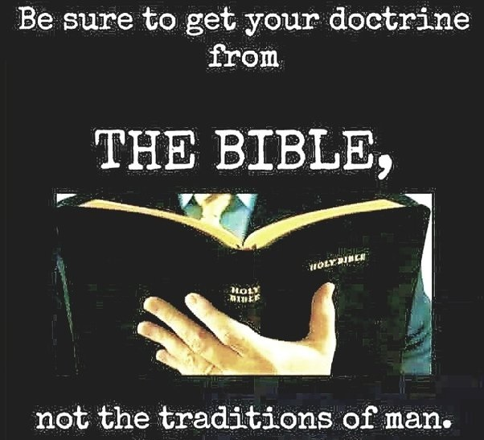
COLOSSIANS 2:11-17 WARNING AGAINST JUDAISTIC CEREMONIALISM (Cond’t)
celebrations and Sabbath day observances in order to be saved.
10/2/2022
27

Slide 28
COLOSSIANS 2:11-17 WARNING AGAINST JUDAISTIC CEREMONIALISM (Cond’t)
2.17 Which are a shadow of things to come; but the body is of Christ.
All these ceremonial observances, were only types and shadows of Christ and the gospel and were meant only to continue in force till Christ came.
10/2/2022
28

Slide 29
COLOSSIANS 2:18-19 WARNING AGAINST ANGEL WORSHIP
2.18 Let no man beguile you of your reward in a voluntary humility and worshipping of angels, intruding into those things which he hath not seen, vainly puffed up by his fleshly mind,
"Let no one beguile you” – don’t be fooled, lured, mesmerized. Paul encourages the Colossian Christians not to fall for false teachings of those who held to mystical practices that were in contrast with God's truth. Paul's list includes four areas used as
10/2/2022
29

Slide 30
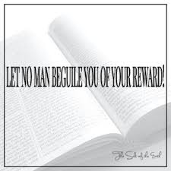
COLOSSIANS 2:18-19 WARNING AGAINST ANGEL WORSHIP (Cond’t)
distractions from true Christian living. First, Paul warns against self-denial such as a vow of silence, prolonged fasting, or lifelong celibacy. Second, Paul notes the "worshipping of angels.“ Third, mystical visions or fortune tellers. Fourth, Paul noted those who use deceptive arguments to promote their teachings.
10/2/2022
30

Slide 31
COLOSSIANS 2:18-19 WARNING AGAINST ANGEL WORSHIP (Cond’t)
2.19 And not holding the Head, from which all the body by joints and bands having nourishment ministered, and knit together, increaseth with the increase of God.
“Not holding the head.“ "Head" is used to signify Jesus and we are members of His body, the church. By "not holding the head," the false teacher’s doctrine amounts to severing the head from the spiritual body of Christ. In Christ there is life and nourishment for growth to "all the body,“ meaning all members of the
10/2/2022
31

Slide 32
COLOSSIANS 2:18-19 WARNING AGAINST ANGEL WORSHIP (Cond’t)
body. The nourishment that comes from the head is said to be supplied by "joints" and "bands." Here Paul is not referring to a joint such as those in a human body, but rather of the bond the true Christian has with his Messiah. The knitting together with the increase speaks of inward spiritual growth in members of the body as a result of members’ being nourished by the head.
10/2/2022
32

Slide 33
COLOSSIANS 2:20-23 WARNING AGAINST ASCETICISM (Cond’t)
concludes they are not bound by the ordinances, which the false apostles endeavored to impose upon them.
10/2/2022
33

Slide 34
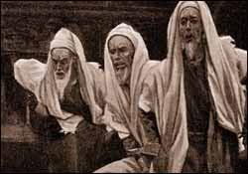
COLOSSIANS 2:20-23 WARNING AGAINST ASCETICISM (Cond’t)
2.21 (Touch not; taste not; handle not;
This statement is an example of the false perspective Paul is condemning. He is giving instruction to the worldly attitude he wants Christians to avoid.
10/2/2022
34

Slide 35
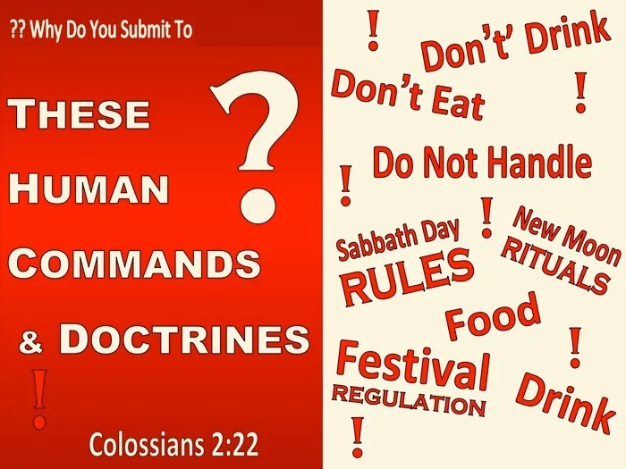
COLOSSIANS 2:20-23 WARNING AGAINST ASCETICISM (Cond’t)
2.22 Which all are to perish with the using;) after the commandments and doctrines of men?
The first part of this verse continues the thought Paul began in verse 21. There, he listed generic rules such as "do not touch…" or "do not eat…" as human regulations. Paul's point
10/2/2022
35

Slide 36
COLOSSIANS 2:20-23 WARNING AGAINST ASCETICISM (Cond’t)
here is that the foods or other items false teachers treat as so important are only temporary and are not matters of eternal importance.
10/2/2022
36

Slide 37
COLOSSIANS 2:20-23 WARNING AGAINST ASCETICISM (Cond’t)
2.23 Which things have indeed a shew of wisdom in will worship, and humility, and neglecting of the body; not in any honour to the satisfying of the flesh.
Paul concludes his teaching against false teachers by again noting how deceptive their approach is. He specifically says their teachings are self-made; they are not actually anything from God. Christ accomplished everything we need to be justified before God.
10/2/2022
37

Slide 38
COLOSSIANS 2:20-23 WARNING AGAINST ASCETICISM (Cond’t)
10/2/2022
38

Slide 39
THIS CONCLUDES COLOSSIANS CHAPTER 2
10/2/2022
39

