Slide 1
1 TIMOTHY CHAPTER 1
7/4/2022
1

Slide 2
PURPOSE
Overall, the message of 1 Timothy concerns sound teaching, while additional themes include how to deal with false teachers in the church; the responsibilities and qualifications of church leaders; appropriate conduct for Christians; and guarding the church's reputation in the world.
7/4/2022
2

Slide 3
SUMMARY
Paul is an apostle of Jesus Christ by the commandment of God. Timothy was Paul’s young disciple to whom he gave many responsibilities. Timothy had been trained in the scriptures by his mother and grandmother and evidently was led to Christ by Paul. Paul regarded Timothy as his son in the faith. Paul commands Timothy to stay in Ephesus, ensuring that no rival doctrine is taught, nor fables and genealogies heeded to. In particular Timothy was to ordain bishops and deacons who were to then lead the church.
7/4/2022
3

Slide 4
1 TIMOTHY
Outline
CHARGE CONCERNING SOUND DOCTRINE
GENERAL INSTRUCTIONS CONCERNING THE CHURCH
ADVICE TO TIMOTHY
INSTRUCTIONS CONCERNING MEMBERS OF THE CHURCH

Slide 5
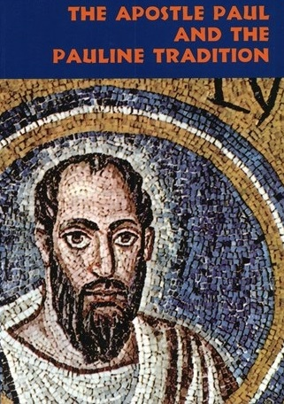
1 TIMOTHY 1:1-2 INTRODUCTION
1.1 Paul, an apostle of Jesus Christ by the commandment of God our Saviour, and Lord Jesus Christ, which is our hope;
Apostle means one sent forth by another, often with a special commission to represent another and to accomplish his work. Paul saw himself as a man with a mission, a
7/4/2022
5

Slide 6
1 TIMOTHY 1:1-2 INTRODUCTION (Cond’t)
"sent one," who was not his own but belonged to His Sender, Christ Jesus. Paul was commissioned as Christ's chosen instrument and ambassador to the Gentiles.
7/4/2022
6

Slide 7
1 TIMOTHY 1:1-2 INTRODUCTION (Cond’t)
1.2 Unto Timothy, my own son in the faith: Grace, mercy, and peace, from God our Father and Jesus Christ our Lord.
“Unto Timothy” clearly marks Timothy as the recipient of this epistle, the same young man Paul refers to as "my son", his son in the faith. Notice in this verse grace precedes the word peace, because it is the grace of God which makes it possible for us to experience peace with God. The source of grace, mercy and peace is God the Father and God the Son, a clear
7/4/2022
7

Slide 8
1 TIMOTHY 1:1-2 INTRODUCTION (Cond’t)
indication that Paul considered Jesus to be fully divine and co-equal with the Father.
7/4/2022
8

Slide 9
1 TIMOTHY 1:3-11 TEACHING SOUND DOCTRINE
1.3 As I besought thee to abide still at Ephesus, when I went into Macedonia, that thou mightest charge some that they teach no other doctrine,
“As I besought thee” refers to some prior time when they had discussed the matter and the charge had been given orally. Paul repeats in writing what he had orally outlined for Timothy, in order that Timothy might have it in black and white, and that he might present it as written evidence to those who objected to
7/4/2022
9

Slide 10
1 TIMOTHY 1:3-11 TEACHING SOUND DOCTRINE (Cond’t)
Timothy’s activities. Paul's purpose for his choice disciple remaining behind at Ephesus was that he might instruct other teachers. The implication is that false teaching was going on and it had be stopped.
7/4/2022
10

Slide 11
1 TIMOTHY 1:3-11 TEACHING SOUND DOCTRINE (Cond’t)
1.4 Neither give heed to fables and endless genealogies, which minister questions, rather than godly edifying which is in faith: so do.
Do not heed or adhere to these false doctrines. While “fables and endless genealogies“ refers to a background of pagan evolutionary philosophy featuring the worship of the nature goddess, Diana.
7/4/2022
11

Slide 12
1 TIMOTHY 1:3-11 TEACHING SOUND DOCTRINE (Cond’t)
These false teachings did not build up Christians or the local church, but instead promoted arguments and divisions.
7/4/2022
12

Slide 13
1 TIMOTHY 1:3-11 TEACHING SOUND DOCTRINE (Cond’t)
1.5 Now the end of the commandment is charity out of a pure heart, and of a good conscience, and of faith unfeigned:
Paul and Timothy's message was given to produce charity(love) from a three-fold origin 1) a pure heart, 2) a good conscience and 3) a faith unfeigned (without pretense). Love is the fruit of the Spirit. A good (beneficial) conscience is one which gives an honest, accurate, reliable self-judgment of one's character. Such a conscience provides fertile soil for growth of
7/4/2022
13

Slide 14
1 TIMOTHY 1:3-11 TEACHING SOUND DOCTRINE (Cond’t)
godly love, a love uncontaminated by false or mixed motives.
7/4/2022
14

Slide 15
1 TIMOTHY 1:3-11 TEACHING SOUND DOCTRINE (Cond’t)
1.6 From which some having swerved have turned aside unto vain jangling;
The false teachers and followers had demonstrated by their deviation from the truth that they had left the straight path of sound doctrine. Their fruitless discussion is devoid of significant results, useless and of no eternal purpose. It was fruitless in that it failed to produce the fruit of the Spirit which is love!
7/4/2022
15

Slide 16
1 TIMOTHY 1:3-11 TEACHING SOUND DOCTRINE (Cond’t)
1.7 Desiring to be teachers of the law; understanding neither what they say, nor whereof they affirm.
Paul gives a scathing indictment against these men as those who did not even know what they were talking about! They declare certain things without understanding what they declare and announce with great confidence.
7/4/2022
16

Slide 17
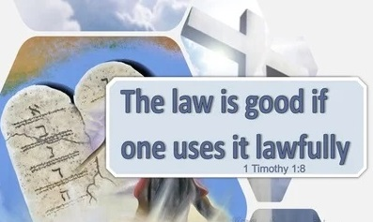
1 TIMOTHY 1:3-11 TEACHING SOUND DOCTRINE (Cond’t)
1.8 But we know that the law is good, if a man use it lawfully;
Teaching the law of God is not wrong. The law used lawfully drives sinners to see their need for Christ and salvation. The law of God is good. It convicts and convinces sinners of their need for God's good news.
7/4/2022
17

Slide 18
1 TIMOTHY 1:3-11 TEACHING SOUND DOCTRINE (Cond’t)
1.9 Knowing this, that the law is not made for a righteous man, but for the lawless and disobedient, for the ungodly and for sinners, for unholy and profane, for murderers of fathers and murderers of mothers, for manslayers,
The purpose of the Law is not to approve the character of the righteous; it is to expose the character of the unrighteous. Paul then lists the types of people who were condemned by the Law. This is a horrible vice list, but sadly Paul is
7/4/2022
18

Slide 19
1 TIMOTHY 1:3-11 TEACHING SOUND DOCTRINE (Cond’t)
not finished! Lawless does not mean they were ignorant of the law, but that they were living without regard for the law, living for self, not Savior, rejecting the law!
7/4/2022
19

Slide 20
1 TIMOTHY 1:3-11 TEACHING SOUND DOCTRINE (Cond’t)
1.10 For whoremongers, for them that defile themselves with mankind, for menstealers, for liars, for perjured persons, and if there be any other thing that is contrary to sound doctrine;
Paul lists 5 more reasons for which the law was given. 1) whoremongers/selling themselves, 2) them that defile themselves with mankind/homosexuals, 3) menstealers/slave-kidnappers, 4) liars, and 5) perjured persons/oath violators Paul then adds a "catch all" phrase, which includes any and all kinds of
7/4/2022
20

Slide 21
1 TIMOTHY 1:3-11 TEACHING SOUND DOCTRINE (Cond’t)
sins which one might name. In sum, Paul's list gives us a guide for identifying the unjustified person, for as Jesus said "by their fruits you shall know them." (Mt 7:16).
7/4/2022
21

Slide 22
1 TIMOTHY 1:3-11 TEACHING SOUND DOCTRINE (Cond’t)
1.11 According to the glorious gospel of the blessed God, which was committed to my trust.
The glorious Gospel prepares sinners for a glorious future. The Gospel has the power to deliver slavery to sin and the consequences of sin and to transfer them to a state of safety, health, well being and eternal preservation. This is the only passage that refers to God as the blessed God. Paul had experienced the power of the Gospel (Rom. 1:16), that had been entrusted
7/4/2022
22
Notes:
Rom. 1:16-For I am not ashamed of the gospel of Christ: for it is the power of God unto salvation to every one that believeth; to the Jew first, and also to the Greek.

Slide 23
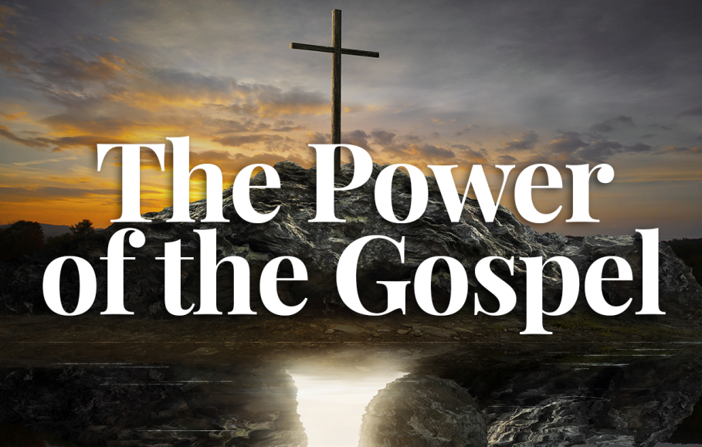
1 TIMOTHY 1:3-11 TEACHING SOUND DOCTRINE (Cond’t)
to him and he passed this same sense of responsibility and accountability on to Timothy.
7/4/2022
23

Slide 24
1 TIMOTHY 1:12-17 THANKSGIVING FOR THE LORD'S GRACE AND MERCY
1.12 And I thank Christ Jesus our Lord, who hath enabled me, for that he counted me faithful, putting me into the ministry;
This verse begins with an outburst of praise for the mercy shown him and his appointment to God’s service. Paul’s soul is stirred to its depth as he thinks of his position as a divinely appointed herald of the Gospel.
7/4/2022
24

Slide 25
1 TIMOTHY 1:12-17 THANKSGIVING FOR THE LORD'S GRACE AND MERCY (Cond’t)
1.13 Who was before a blasphemer, and a persecutor, and injurious: but I obtained mercy, because I did it ignorantly in unbelief.
This indicates a kind of arrogant man who is out to inflict pain for the sheer joy of inflicting it. Paul makes a full record of his guilt in order that he may magnify the grace which saved even the chief of sinners. Paul is not saying that his ignorance and unbelief were the grounds of God's mercy, but that God
7/4/2022
25

Slide 26
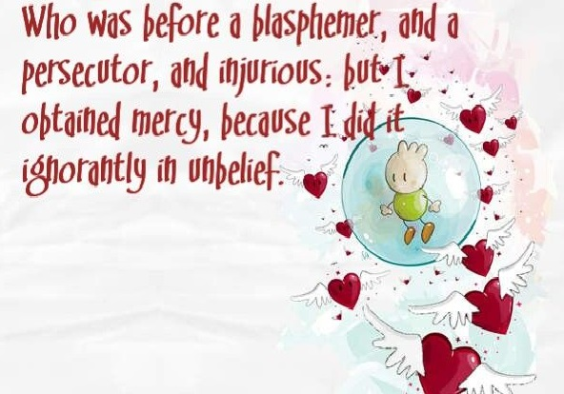
1 TIMOTHY 1:12-17 THANKSGIVING FOR THE LORD'S GRACE AND MERCY (Cond’t)
graciously granted him what he needed, not what he deserved.
7/4/2022
26

Slide 27
1 TIMOTHY 1:12-17 THANKSGIVING FOR THE LORD'S GRACE AND MERCY (Cond’t)
1.14 And the grace of our Lord was exceeding abundant with faith and love which is in Christ Jesus.
Note Paul begins “and the grace” which connects with the bestowing of mercy in the preceding verse. Paul deserved justice but received mercy and undeserved grace even though he was a guilty sinner.
7/4/2022
27

Slide 28
1 TIMOTHY 1:12-17 THANKSGIVING FOR THE LORD'S GRACE AND MERCY (Cond’t)
1.15 This is a faithful saying, and worthy of all acceptation, that Christ Jesus came into the world to save sinners; of whom I am chief.
This faithful statement is the heart of the Gospel. “Christ Jesus came” speaks of Christ taking the form of a man. “To save sinners” speaks of His taking the sins of men upon Himself as their substitutionary sacrifice. Note the last part of the verse where Paul says “I am chief” of all indicates he never got over the fact that he
7/4/2022
28

Slide 29
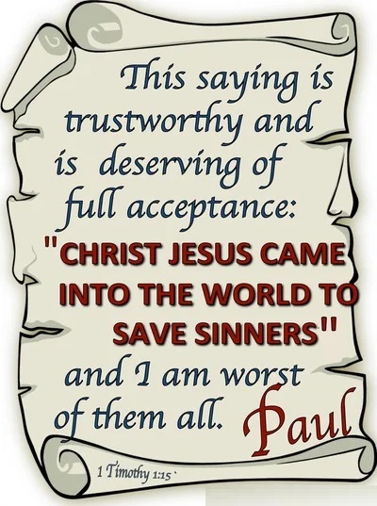
1 TIMOTHY 1:12-17 THANKSGIVING FOR THE LORD'S GRACE AND MERCY (Cond’t)
was a sinner saved by grace.
7/4/2022
29

Slide 30
1 TIMOTHY 1:12-17 THANKSGIVING FOR THE LORD'S GRACE AND MERCY (Cond’t)
1.16 Howbeit for this cause I obtained mercy, that in me first Jesus Christ might shew forth all longsuffering, for a pattern to them which should hereafter believe on him to life everlasting.
Paul had just stated he was the chief of sinners, and here he is explaining why he received this mercy, why he was saved. The reason has nothing to do with Paul. The reason is Jesus, something in Jesus, namely his “longsuffering,”
7/4/2022
30

Slide 31
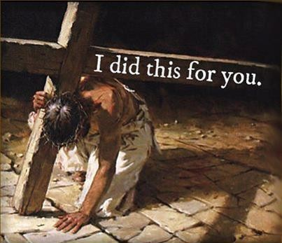
1 TIMOTHY 1:12-17 THANKSGIVING FOR THE LORD'S GRACE AND MERCY (Cond’t)
meaning holding out long under provocation. He further shows, if one as great a sinner as he, had the door of mercy and salvation flung wide open by grace; then that door was opened to all who acknowledges their sin and need of a Savior.
7/4/2022
31

Slide 32
1 TIMOTHY 1:12-17 THANKSGIVING FOR THE LORD'S GRACE AND MERCY (Cond’t)
1.17 Now unto the King eternal, immortal, invisible, the only wise God, be honour and glory for ever and ever. Amen.
As King, God’s sovereign rule is over every person, over every thing, in every place, and over every time, now and forever. God had no beginning and will have no end and therefore is eternal. He exists outside of time, though He acts in it. He is immortal and thus not subject to decay or corruption. While God is invisible,
7/4/2022
32

Slide 33
1 TIMOTHY 1:12-17 THANKSGIVING FOR THE LORD'S GRACE AND MERCY (Cond’t)
Jesus is the radiance of His glory and the exact representation of His nature (John 1:18). God emphasizes His uniqueness. There is none like Him! Honor is the esteem and reverence, and glory is the acknowledgment of our praise. The phrase forever and ever literally means unto the ages of the ages.
7/4/2022
33
Notes:
John 1:18-No man hath seen God at any time; the only begotten Son, which is in the bosom of the Father, he hath declared him.

Slide 34
1 TIMOTHY 1:18-20 TIMOTHY'S RESPONSIBILITY
1.18 This charge I commit unto thee, son Timothy, according to the prophecies which went before on thee, that thou by them mightest war a good warfare;
In giving this command Paul is exercising his apostolic authority. While “I commit” speaks of entrusting something of great value to another's safe keeping. The phase “according to the prophecies” means prophecies previously spoken of what God would do through him. These prophecies would have the effect of
7/4/2022
34

Slide 35
1 TIMOTHY 1:18-20 TIMOTHY'S RESPONSIBILITY
strengthening and motivating him to fight a good fight against false teachers who were in the church.
7/4/2022
35

Slide 36
1 TIMOTHY 1:18-20 TIMOTHY'S RESPONSIBILITY (Cond’t)
1.19 Holding faith, and a good conscience; which some having put away concerning faith have made shipwreck:
The conscience is a monitoring mechanism which God has given to man to approve right conduct and to protest against what is wrong. Therefore a good conscience is the rudder that steers the Christian life. Christians who
7/4/2022
36

Slide 37
1 TIMOTHY 1:18-20 TIMOTHY'S RESPONSIBILITY (Cond’t)
"make shipwreck" of their faith do so by sinning against their conscience. They allow their own wishes and desires to speak with more power and persuasiveness than the voice of God.
7/4/2022
37

Slide 38
1 TIMOTHY 1:18-20 TIMOTHY'S RESPONSIBILITY (Cond’t)
1.20 Of whom is Hymenaeus and Alexander; whom I have delivered unto Satan, that they may learn not to blaspheme.
Paul viewed the world as Satan’s domain. To be in the church, under the authority of the elders, provides a person a certain amount of protection from the devil. What Paul probably means is that these two men were delivered over to Satan’s domain, the world, by being excommunicated from the protective covering
7/4/2022
38

Slide 39
1 TIMOTHY 1:18-20 TIMOTHY'S RESPONSIBILITY (Cond’t)
of the church and from the fellowship of its members. The goal of any disciple is to restore, not to punish. Paul’s desire was not to get rid of these men, but “that they may learn not to blaspheme.”
7/4/2022
39

Slide 40
THIS CONCLUDES 1 TIMOTHY CHAPTER 1
7/4/2022
40

