Slide 1
1 TIMOTHY CHAPTER 5
7/31/2022
1

Slide 2
SUMMARY
Do not rebuke an older man, but exhort him as a father. Treat young men as brothers, older women as mothers, younger women as sisters. Help widows who are really widows and who have no family to assist them. If widows live in pleasure, they are dead while they live. Everyone should provide for their own. Only help widows if they are over sixty, and well reported for good works. Younger widows are in danger of becoming gossips and busybodies, and turning to Satan. Paul recommends that
7/31/2022
2

Slide 3
SUMMARY (Cond’t)
they remarry. Elders who labor in the word and doctrine are to be honored. Do not receive an accusation against an elder unless there are two or three witnesses. Publically rebuke those who sin. Do not be prejudiced or show partiality. Do not lay hands on anyone hastily. Drink wine occasionally for the health of your stomach. Some sins are evident, and some more hidden – it is the same with good works.
7/31/2022
3

Slide 4
1 TIMOTHY 5
Outline
MAINTAIN PROPER RELATIONSHIPS
CONCERNING WIDOWS
CONCERNING ELDERS

Slide 5
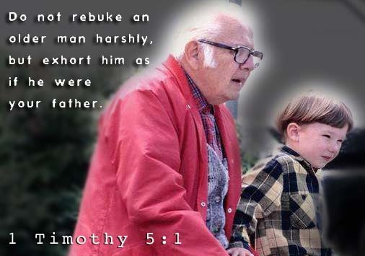
1 TIMOTHY 5:1-2 MAINTAIN PROPER RELATIONSHIPS
5.1 Rebuke not an elder, but intreat him as a father; and the younger men as brethren;
Here “elder” refers to any older man in the church. Paul focuses on how Timothy is to treat different groups of people within the church. As their spiritual leader Timothy is to treat any older man in the church as a father and any younger men as brothers.
7/31/2022
5

Slide 6
1 TIMOTHY 5:1-2 MAINTAIN PROPER RELATIONSHIPS (Cond’t)
5.2 The elder women as mothers; the younger as sisters, with all purity.
Here Paul teaches about the relationships Timothy is to have with the older and younger women in the church. He tells Timothy to relate to women in the church as if they are your very own family members. In addition he was to guard his heart with more than common vigilance in such circumstances, and was to indulge in no word, or look, or action, which
7/31/2022
6

Slide 7
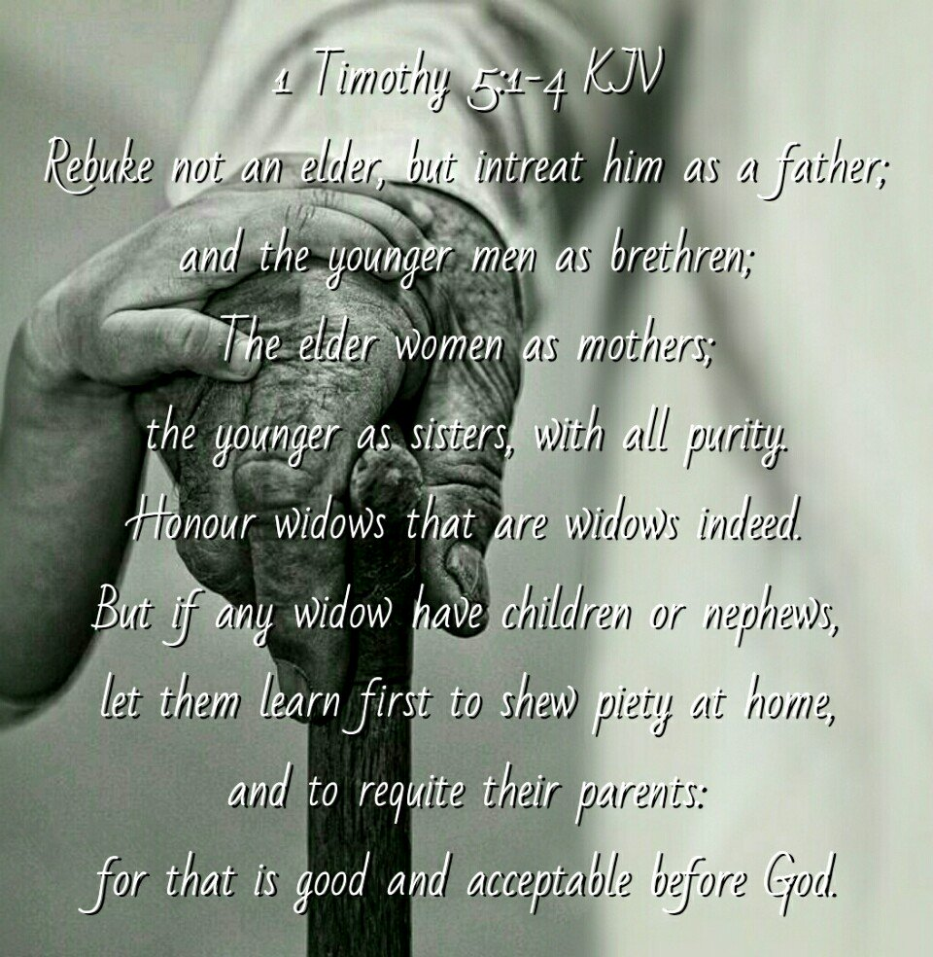
1 TIMOTHY 5:1-2 MAINTAIN PROPER RELATIONSHIPS (Cond’t)
could be construed as improper.
7/31/2022
7

Slide 8
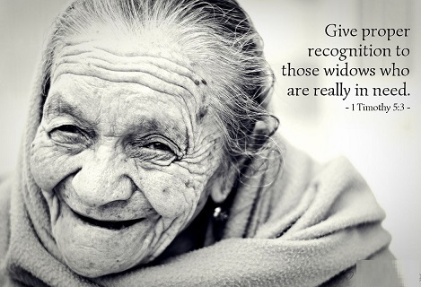
1 TIMOTHY 5:3-16 CONCERNING WIDOWS
5.3 Honour widows that are widows indeed.
Paul seeks to define for Timothy who are the true widows. Widows who are desolate, and not able to maintain themselves; they have no near relations to provide for them, but are wholly devoted to God.
7/31/2022
8

Slide 9
1 TIMOTHY 5:3-16 CONCERNING WIDOWS (Cond’t)
5.4 But if any widow have children or nephews, let them learn first to shew piety at home, and to requite their parents: for that is good and acceptable before God.
Nephews here makes reference to any close descendants. It is the Christian’s duty to care for one’s aging relatives, which includes any widows. The church should not be burdened, so that it may help the widows who are truly in need.
7/31/2022
9

Slide 10
1 TIMOTHY 5:3-16 CONCERNING WIDOWS (Cond’t)
5.5 Now she that is a widow indeed, and desolate, trusteth in God, and continueth in supplications and prayers night and day.
Here Paul alludes to a widow who is destitute, forsaken and reduced to solitude, having neither children nor any relatives to help her. She has no one to trust but God. She devotes her- self wholly to the service of God, praying day and night.
7/31/2022
10

Slide 11
1 TIMOTHY 5:3-16 CONCERNING WIDOWS (Cond’t)
5.6 But she that liveth in pleasure is dead while she liveth.
Any woman who lives for pleasure is dead in respect to God, whom she does not serve. She is spiritually dead, though she may still be alive physically.
7/31/2022
11

Slide 12
1 TIMOTHY 5:3-16 CONCERNING WIDOWS (Cond’t)
5.7 And these things give in charge, that they may be blameless.
The charge is given to the leaders of the church to carryout these responsibilities regarding those who were “widows indeed.”
7/31/2022
12

Slide 13
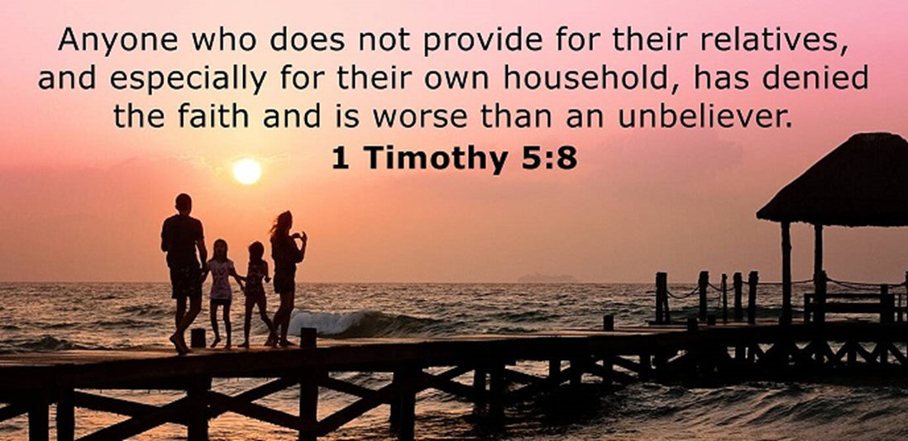
1 TIMOTHY 5:3-16 CONCERNING WIDOWS (Cond’t)
5.8 But if any provide not for his own, and specially for those of his own house, he hath denied the faith, and is worse than an infidel.
Though the church has a significant responsibility to widows, family members of those in need have a much greater responsibility.
7/31/2022
13

Slide 14
1 TIMOTHY 5:3-16 CONCERNING WIDOWS (Cond’t)
Failure to take care of one’s family is equal to denying the faith and worse than a non-believer.
7/31/2022
14

Slide 15
1 TIMOTHY 5:3-16 CONCERNING WIDOWS (Cond’t)
5.9 Let not a widow be taken into the number under threescore years old, having been the wife of one man,
Here Paul is speaking of widows who were not to be taken under the church's care if they were under threescore(60) years old. It might be thought that widows under age 60 would likely remarry, and so not be desolate, or they might be capable of labor, and taking care of themselves. However, Paul excluded widows who had been guilty of putting away their
7/31/2022
15

Slide 16
1 TIMOTHY 5:3-16 CONCERNING WIDOWS (Cond’t)
husband, and marring another.
7/31/2022
16

Slide 17
1 TIMOTHY 5:3-16 CONCERNING WIDOWS (Cond’t)
5.10 Well reported of for good works; if she have brought up children, if she have lodged strangers, if she have washed the saints' feet, if she have relieved the afflicted, if she have diligently followed every good work.
This verse continues Paul's description of the "true widows" who are to be prioritized as the church seeks to provide material support. In addition to the two requirements in the previous verse, Paul now gives five specific requirements and a general summary. 1) The woman should have a reputation of Christian
7/31/2022
17

Slide 18
1 TIMOTHY 5:3-16 CONCERNING WIDOWS (Cond’t)
conduct. 2) She actually cared for children she might have had without abandoning them. 3) She has a reputation for hospitality. 4) She performed the literal act of washing feet which is a general reference to serving others. 5) She relieved the afflicted; either in body, with her purse; or in mind, by visiting them, and speaking comfort to them. He concludes with a general summary, indicating that the woman should be known for her commitment to Christ-like behavior.
7/31/2022
18

Slide 19
1 TIMOTHY 5:3-16 CONCERNING WIDOWS (Cond’t)
5.11 But the younger widows refuse: for when they have begun to wax wanton against Christ, they will marry;
Do not take any young widows into this list of those to be supported by the church. The word “wanton” in this verse means “wandering” from moral decency, shameless, or depraved. Most likely as time goes on, they will wish to marry.
7/31/2022
19

Slide 20
1 TIMOTHY 5:3-16 CONCERNING WIDOWS (Cond’t)
5.12 Having damnation, because they have cast off their first faith.
The reason is that the "true widows" prioritized by the church are those fully devoted to serving others. Upon remarrying, young widows would break this commitment of being fully devoted to others. In ancient times, a pledge
7/31/2022
20

Slide 21
1 TIMOTHY 5:3-16 CONCERNING WIDOWS (Cond’t)
or commitment was considered of tremendous importance and breaking it would incur condemnation.
7/31/2022
21

Slide 22
1 TIMOTHY 5:3-16 CONCERNING WIDOWS (Cond’t)
5.13 And withal they learn to be idle, wandering about from house to house; and not only idle, but tattlers also and busybodies, speaking things which they ought not.
Three additional problems with providing for the needs of younger widows are mentioned in this verse. 1) giving charity to those who are capable of providing for themselves breeds apathy and laziness. An "idler," as used here, is someone who is unproductive or does not work.
7/31/2022
22

Slide 23
1 TIMOTHY 5:3-16 CONCERNING WIDOWS (Cond’t)
2) Paul warns that rather than being occupied with constructive work, they have time and temptation to become "gossips“(Romans 1:29; 2 Corinthians 12:20). 3) The risk of young widows becoming "busybodies" which implies being overly concerned with the business of others (2 Thessalonians 3:11)
7/31/2022
23
Notes:
Romans 1:29-Being filled with all unrighteousness, fornication, wickedness, covetousness, maliciousness; full of envy, murder, debate, deceit, malignity; whisperers,
2 Corinthians 12:20-For I fear, lest, when I come, I shall not find you such as I would, and that I shall be found unto you such as ye would not: lest there be debates, envyings, wraths, strifes, backbitings, whisperings, swellings, tumults:
2 Thessalonians 3:11-For we hear that there are some which walk among you disorderly, working not at all, but are busybodies.

Slide 24
1 TIMOTHY 5:3-16 CONCERNING WIDOWS (Cond’t)
5.14 I will therefore that the younger women marry, bear children, guide the house, give none occasion to the adversary to speak reproachfully.
Paul encourages younger widows to do four things. First, he recommends young widows get married rather than falling on the charity of the church. Second, younger widows who remarry are encouraged to "bear children." This connects again with the concept of childbearing Paul mentioned in
7/31/2022
24

Slide 25
1 TIMOTHY 5:3-16 CONCERNING WIDOWS (Cond’t)
1 Timothy 2:15. Third, young widows who remarry are to "manage their households." This general command is another reference to being productive and caring for one's family. Fourth, a younger widow was to live in such a way that Satan would have no room to attack her (1 Tim 5:15).
7/31/2022
25
Notes:
1 Timothy 2:15-Notwithstanding she shall be saved in childbearing, if they continue in faith and charity and holiness with sobriety.
1 Tim 5:15-For some are already turned aside after Satan.

Slide 26
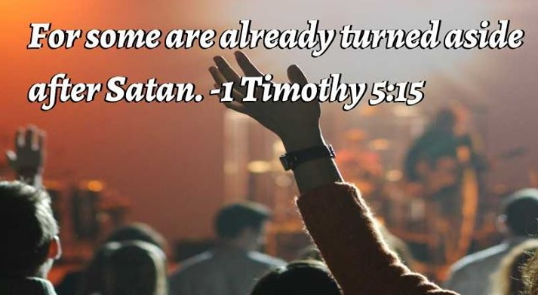
1 TIMOTHY 5:3-16 CONCERNING WIDOWS (Cond’t)
5.15 For some are already turned aside after Satan.
Prior verses explained the dangers of this error, and it seems likely Paul is referring to instances where those problems had already become a reality in the church. Some individuals in the church were not merely living for personal gain, but were actively following the plans of the Devil.
7/31/2022
26

Slide 27
1 TIMOTHY 5:3-16 CONCERNING WIDOWS (Cond’t)
5.16 If any man or woman that believeth have widows, let them relieve them, and let not the church be charged; that it may relieve them that are widows indeed.
This verse emphasizes that Paul has been specifically speaking to believers (man or woman) in the church. Here, he clarifies that Christians are to care for their relatives who are widows. The group referred to here with the word "them" could include a mother, grandmothers, and possibly other extended
7/31/2022
27

Slide 28
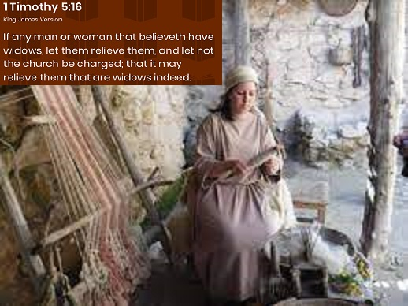
1 TIMOTHY 5:3-16 CONCERNING WIDOWS (Cond’t)
family members. Do not unnecessarily burden the Church with their maintenance, that the funds may be spared for the support of those widows desolate, without support, and without relatives who were employed in service to the church.
7/31/2022
28

Slide 29
1 TIMOTHY 5:17-25 CONCERNING ELDERS
5.17 Let the elders that rule well be counted worthy of double honour, especially they who labour in the word and doctrine.
Here, Paul addresses the "elders that rule well." Those who oversee appropriately are worthy of "double honor." This honor is especially for those whose primary task is pastoral "they who labor in word (preaching) and doctrine (teaching)”.
7/31/2022
29

Slide 30
1 TIMOTHY 5:17-25 CONCERNING ELDERS (Cond’t)
5.18 For the scripture saith, Thou shalt not muzzle the ox that treadeth out the corn. And, The labourer is worthy of his reward.
The first quote regarding an ox and grain is from Deuteronomy 25:4. Putting a muzzle on the ox would prevent it from eating grain while it was working but it also means the ox can't replenish its strength while it works. The second quote, "The laborer worthy of his rewards" reinforces Paul's teaching that elders who work hard are to be paid for their
7/31/2022
30
Notes:
Deuteronomy 25:4-Thou shalt not muzzle the ox when he treadeth out the corn.

Slide 31
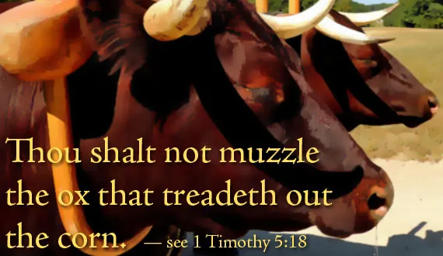
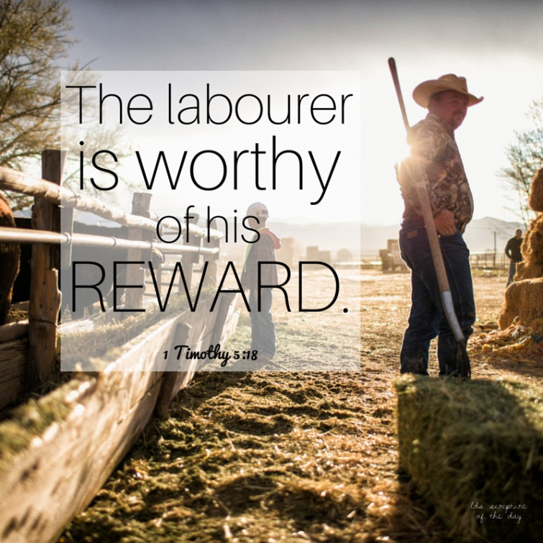
1 TIMOTHY 5:17-25 CONCERNING ELDERS (Cond’t)
efforts. This is primarily so they can devote their time and energy fully to service of the congregation.
7/31/2022
31

Slide 32
1 TIMOTHY 5:17-25 CONCERNING ELDERS (Cond’t)
5.19 Against an elder receive not an accusation, but before two or three witnesses.
Here, Paul transitions from honoring elders to how to properly handle accusations against them. According to Paul, an accusation was not to be taken seriously unless it came with the evidence of two or three witnesses. The reason for this is those whose business it is to correct others will usually have many enemies; great caution, therefore, should be used in admitting accusations against such persons.
7/31/2022
32

Slide 33
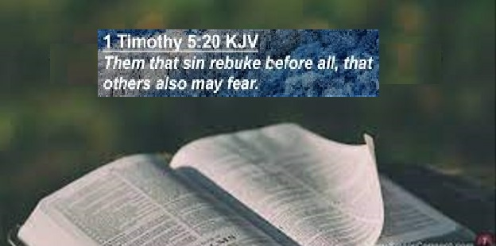
1 TIMOTHY 5:17-25 CONCERNING ELDERS (Cond’t)
5.20 Them that sin rebuke before all, that others also may fear.
If an elder is clearly in sin and persisting in it, Paul says to rebuke them in the presence of all. This appears to indicate public notification within a church gathering. Paul's reason for teaching this was “that others” referring here to elders specifically, but also the entire congregation “may fear.”
7/31/2022
33

Slide 34
1 TIMOTHY 5:17-25 CONCERNING ELDERS (Cond’t)
5.21 I charge thee before God, and the Lord Jesus Christ, and the elect angels, that thou observe these things without preferring one before another, doing nothing by partiality.
Paul's command to Timothy is to not back down or be timid regarding enforcement of rebuking and removing sinning elders/pastors. This would likely be the most difficult work he would face as a church leader, but Paul emphasized that it must be done. The phrase "without preferring" is the
7/31/2022
34

Slide 35
1 TIMOTHY 5:17-25 CONCERNING ELDERS (Cond’t)
idea of without bias, meaning he couldn't favor elders he liked or more harshly judge those he did not like; he had to deal with the evidence and facts of each situation.
7/31/2022
35

Slide 36
1 TIMOTHY 5:17-25 CONCERNING ELDERS (Cond’t)
5.22 Lay hands suddenly on no man, neither be partaker of other men's sins: keep thyself pure.
“Lay hands on no man” is used in the sense of ordination to recognizes God’s calling . Paul cautioned Timothy to let a man prove himself before he was recognized in ministry. There should not be a rush; time must season a man and his ministry. We are not to share in other people’s sins. 1) We can share in the sins of others by setting a bad example before them.
7/31/2022
36

Slide 37
1 TIMOTHY 5:17-25 CONCERNING ELDERS (Cond’t)
2) We can share in the sins of others by approving of them or ignoring them. 3) We can share in the sins of others by joining a church that spreads dangerous teachings. Timothy was also commanded by Paul to “keep thyself pure.” The intention of the warning would be that if Timothy was to observe and assess the lives of others, it was important that he pay even more attention to his own life.
7/31/2022
37

Slide 38
1 TIMOTHY 5:17-25 CONCERNING ELDERS (Cond’t)
5.23 Drink no longer water, but use a little wine for thy stomach's sake and thine often infirmities.
This side-note addresses Timothy's physical health. Paul had mentioned the importance of physical fitness in 1 Timothy 4:8. Here, he speaks regarding Timothy's diet. Timothy apparently did not drink any wine at this point, consuming only water. However, Timothy seems to have experienced digestive or physical problems. To help, Paul commanded
7/31/2022
38

Slide 39
1 TIMOTHY 5:17-25 CONCERNING ELDERS (Cond’t)
him to drink "a little wine“. It’s obvious that Paul was not advocating social drinking in this passage. The Greek word oinos refers to both an alcoholic fermented beverage as well as unfermented grape juice. According to Isaiah 65:8, the new wine is found in a cluster and there is blessing in it. This passage is obviously speaking of the unfermented, freshly squeezed juice of the grape.
7/31/2022
39

Slide 40
1 TIMOTHY 5:17-25 CONCERNING ELDERS (Cond’t)
5.24 Some men's sins are open beforehand, going before to judgment; and some men they follow after.
This verse and the next form a conclusion to Paul's section regarding the treatment of elders in the church. Four categories of people are mentioned, with the first two groups in this verse. First, Paul writes about those whose sins are obvious and known to all. This means those whose flaws and errors are already known to the world, before being revealed and judged in
7/31/2022
40

Slide 41
1 TIMOTHY 5:17-25 CONCERNING ELDERS (Cond’t)
eternity (Matthew 12:36). The second category refers to those sins which are hidden, obscured, or simply undiscovered. Some men are especially clever at concealing their sins. Their sins "appear later," meaning they will eventually be known, either in this life or after death.
7/31/2022
41
Notes:
Matthew 12:36-But I say unto you, That every idle word that men shall speak, they shall give account thereof in the day of judgment.

Slide 42
1 TIMOTHY 5:17-25 CONCERNING ELDERS (Cond’t)
5.25 Likewise also the good works of some are manifest beforehand; and they that are otherwise cannot be hid.
In this verse Paul mentions two categories of people known for good works. First, he writes that some good deeds are obvious to others and seen by many people. Second, however, are good works which are not as clear. Just as human eyes can miss the hidden sins of others, so too can human eyes miss the good done by fellow human beings. And yet, both sins and
7/31/2022
42

Slide 43
1 TIMOTHY 5:17-25 CONCERNING ELDERS (Cond’t)
good works are known by God. Even minor, less obvious, or secret good deeds cannot be hidden from God (Matthew 6:4) for He sees everything.
7/31/2022
43
Notes:
Matthew 6:4-That thine alms may be in secret: and thy Father which seeth in secret himself shall reward thee openly.

Slide 44
THIS CONCLUDES 1 TIMOTHY CHAPTER 5
7/31/2022
44

