Slide 1
COLOSSIANS CHAPTER 1
9/28/2022
1

Slide 2
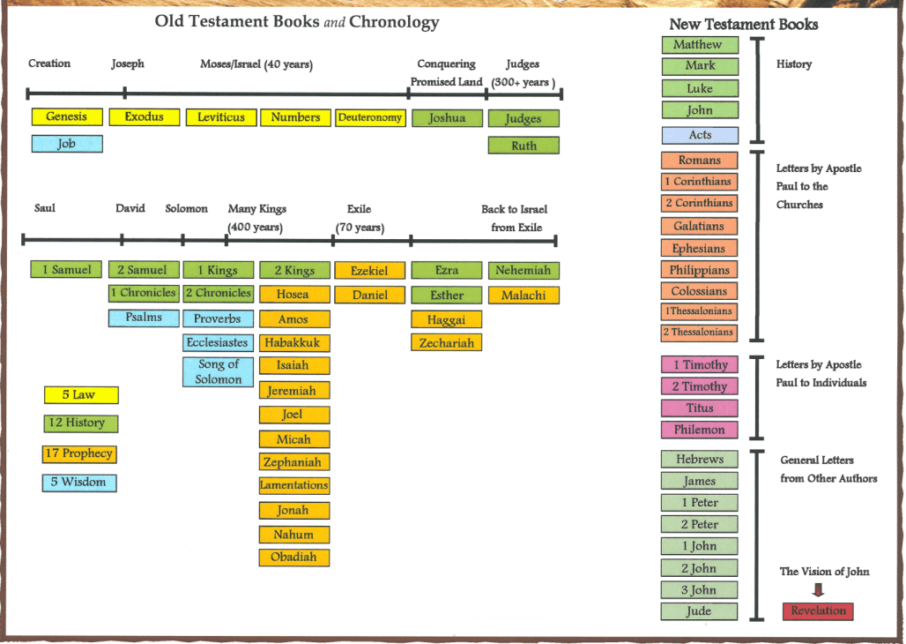
Abt 62 AD

Slide 3
PURPOSE
The Book of Colossians is a guide for Christians showing how to live in this world and before God. Colossians is rich in the study of Jesus Christ and His divine attributes and utter supremacy and His coming back to judge the world in righteousness. It also addresses problems in the church and challenges believers to examine their lives and be transformed through the love of Jesus.
9/28/2022
3

Slide 4
SUMMARY
This epistle was written to the faithful Saints in Colossae, a site in modern-day Turkey located close to the city of Laodicea. Paul wrote this epistle after he was visited by Epaphras, the evangelist of the Church in Colossae who is credited with reaching this city with the gospel . Epaphras told Paul that the Colossians were falling into serious error—they thought they were better than other people because they carefully observed certain external ordinances, denied themselves certain physical wants, and worshiped angels. These practices made the
9/28/2022
4

Slide 5
SUMMARY(Cond’t)
Colossians feel they were being sanctified.
They also felt they understood the mysteries of the universe better than other Church members. In his letter, Paul corrected them by teaching that redemption comes only through Christ and that we are to be wise and serve Him.
9/28/2022
5

Slide 6
COLOSSIANS 1:1-2 SALUTATION
1.1 Paul, an apostle of Jesus Christ by the will of God, and Timotheus our brother,
This verse begins with a greeting in Paul's typical fashion; he states his name and information about himself.
9/28/2022
6

Slide 7
COLOSSIANS 1:1-2 SALUTATION (Cond’t)
Timothy shares also in the greeting of the Epistle. Note also he calls him “our brother,” rather than his son.
9/28/2022
7

Slide 8
COLOSSIANS 1:1-2 SALUTATION (Cond’t)
1.2 To the saints and faithful brethren in Christ which are at Colosse: Grace be unto you, and peace, from God our Father and the Lord Jesus Christ.
The word "saints" here refers to all saved believers. Paul now states information about recipients and follows this with a brief greeting. The greeting includes the phrase "Grace be unto you and peace from God our Father and the Lord Jesus Christ." The phrase "grace to you" begins all four of his Prison Epistles and is
9/28/2022
8

Slide 9
COLOSSIANS 1:1-2 SALUTATION (Cond’t)
found in all of Paul's letters except his letters to Timothy and Titus. Paul presents Jesus as equal with God the Father, yet distinguishes between Father and Son as well.
9/28/2022
9

Slide 10
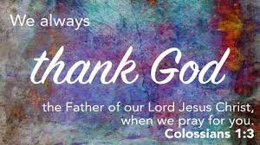
COLOSSIANS 1:3-14 THANKSGIVING AND PRAYER
1.3 We give thanks to God and the Father of our Lord Jesus Christ, praying always for you,
Paul's letter opens immediately with gratitude. Paul was a man of prayer, often opening his letters with thanks (Philippians 1:3). Paul focuses his prayer on all of the believers in Colossae. He rejoices at the knowledge of a group of believers thriving apart from his leadership.
9/28/2022
10
Notes:
Philippians 1:3-I thank my God upon every remembrance of you,

Slide 11
COLOSSIANS 1:3-14 THANKSGIVING AND PRAYER (Cond’t)
1.4 Since we heard of your faith in Christ Jesus, and of the love which ye have to all the saints,
The "we" Paul uses in this verse also includes Timothy. Timothy was with Paul in Rome during his imprisonment. Although Paul will give the Colossians correction regarding various concerns in this letter, he still clearly accepts the church in Colossae as true believers because of their faith in Jesus Christ. These believers also had great love for one another.
9/28/2022
11

Slide 12
COLOSSIANS 1:3-14 THANKSGIVING AND PRAYER (Cond’t)
1.5 For the hope which is laid up for you in heaven, whereof ye heard before in the word of the truth of the gospel;
The reason Paul and Timothy could continually give thanks to God (Colossians 1:3) is explained as "the hope which is laid up for you in heaven.“ This is a reference to salvation and eternal life for Paul's readers. This verse also describes the gospel as "the word of the truth." The word literally means "good news," of Jesus Christ, as well as a more general reference to
9/28/2022
12

Slide 13
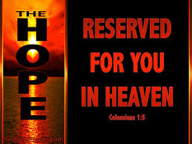
COLOSSIANS 1:3-14 THANKSGIVING AND PRAYER (Cond’t)
truths about Christ.
9/28/2022
13

Slide 14
COLOSSIANS 1:3-14 THANKSGIVING AND PRAYER (Cond’t)
1.6 Which is come unto you, as it is in all the world; and bringeth forth fruit, as it doth also in you, since the day ye heard of it, and knew the grace of God in truth:
Paul notes the gospel was already spreading throughout the world. Paul is not writing to unbelievers, but to an existing church in Colossae. The gospel was “bringeth forth fruit” among them, and had been ever since it was first accepted by people of the city. The "day" is likely a general reference meaning since the
9/28/2022
14

Slide 15
COLOSSIANS 1:3-14 THANKSGIVING AND PRAYER (Cond’t)
time it was brought to them.
9/28/2022
15

Slide 16
COLOSSIANS 1:3-14 THANKSGIVING AND PRAYER (Cond’t)
1.7 As ye also learned of Epaphras our dear fellowservant, who is for you a faithful minister of Christ;
Christianity took root in Colossae thanks to the work of Epaphras who initially brought the gospel to the city. Paul notes two positive characteristics about Epaphras in this verse. First, Epaphras is known for serving the Lord and second, he is described as a man of faithful ministry.
9/28/2022
16

Slide 17
COLOSSIANS 1:3-14 THANKSGIVING AND PRAYER (Cond’t)
1.8 Who also declared unto us your love in the Spirit.
This verse completes the thought which Paul began in verse 7. The use of "the Spirit" in this verse is of great importance. Verses 6 and 7 mention God and Christ, with the Spirit in this verse completing a clear picture of the Triune God: Father, Son, and Spirit.
9/28/2022
17

Slide 18
COLOSSIANS 1:3-14 THANKSGIVING AND PRAYER (Cond’t)
1.9 For this cause we also, since the day we heard it, do not cease to pray for you, and to desire that ye might be filled with the knowledge of his will in all wisdom and spiritual understanding;
This passage transitions from Paul's thankfulness into a prayer for the Colossian believers. Paul states that he and Timothy have been praying constantly, presumably from the moment they learned about the Colossian church. Paul and Timothy's prayer includes
9/28/2022
18

Slide 19
COLOSSIANS 1:3-14 THANKSGIVING AND PRAYER (Cond’t)
asking for knowledge of Christ’s will, wisdom and spiritual understanding among the Colossian believers.
9/28/2022
19

Slide 20
COLOSSIANS 1:3-14 THANKSGIVING AND PRAYER (Cond’t)
1.10 That ye might walk worthy of the Lord unto all pleasing, being fruitful in every good work, and increasing in the knowledge of God;
This verse completes the prayer which Paul began in verse 9. Here, he states why he prays for their knowledge, wisdom, and understanding. 1) Paul's desire is for their actions to match their beliefs. 2) Paul wants these believers to be “all pleasing" to the Lord. Pleasing God includes believing in Him and
9/28/2022
20

Slide 21
COLOSSIANS 1:3-14 THANKSGIVING AND PRAYER (Cond’t)
living a life that follows His teachings. 3) Paul wants these believers to be effective, productive, and godly in their spiritual growth. The idea of bearing fruit implies maturity. Paul longed for all of his fellow believers to grow in maturity as part of their Christian walk (Ephesians 4:11–13). 4) Paul wants the Colossians to continue to learn more about their faith and the God they serve. Knowledge of God involves learning the truth of the gospel and the Scriptures (2 Timothy 3:16–17). Growing in God's will is more general,
9/28/2022
21
Notes:
Ephesians 4:11–13-And he gave some, apostles; and some, prophets; and some, evangelists; and some, pastors and teachers;
12For the perfecting of the saints, for the work of the ministry, for the edifying of the body of Christ:
13Till we all come in the unity of the faith, and of the knowledge of the Son of God, unto a perfect man, unto the measure of the stature of the fulness of Christ:
2 Timothy 3:16–17-Al l scripture is given by inspiration of God, and is profitable for doctrine, for reproof, for correction, for instruction in righteousness:
17That the man of God may be perfect, throughly furnished unto all good works.

Slide 22
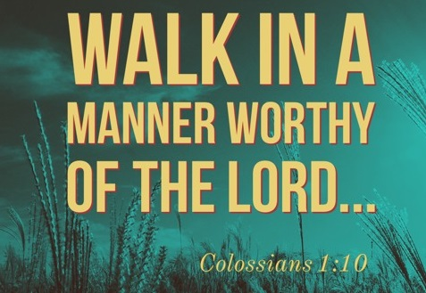
COLOSSIANS 1:3-14 THANKSGIVING AND PRAYER (Cond’t)
including learning how to practically apply our knowledge. This knowledge also includes God's specific desires for our individual lives. Paul emphasizes the importance of both general knowledge, and knowledge of God's will in the life of a believer.
9/28/2022
22

Slide 23
COLOSSIANS 1:3-14 THANKSGIVING AND PRAYER (Cond’t)
1.11 Strengthened with all might, according to his glorious power, unto all patience and longsuffering with joyfulness;
Paul continues his prayer for the Colossian Christians by asking they be given additional power. Specifically, Paul prays for them to receive the power of God. 1) God's power gives patience. Patience is part of the fruit of the Spirit (Galatians 5:22–23) and is an essential part of Christian maturity. 2) God's power provides longsuffering, which is the ability to withstand
9/28/2022
23
Notes:
Galatians 5:22–23-But the fruit of the Spirit is love, joy, peace, longsuffering, gentleness, goodness, faith,
23Meekness, temperance: against such there is no law.

Slide 24
COLOSSIANS 1:3-14 THANKSGIVING AND PRAYER (Cond’t)
hardship without failing. 3) God's power gives joyfulness which is also part of the fruit of the Spirit. Joy is one of the clearest differences between the life of the believer and the unbeliever.
9/28/2022
24

Slide 25
COLOSSIANS 1:3-14 THANKSGIVING AND PRAYER (Cond’t)
1.12 Giving thanks unto the Father, which hath made us meet to be partakers of the inheritance of the saints in light:
Just as Paul prayed, giving thanks continually, (1 Thessalonians 5:16–18), they were to give thanks as well. He makes it clear that God alone is the one who provides salvation. Paul also makes mention “in light” which according to the Jewish people, all knowledge and goodness was symbolized by light.
9/28/2022
25
Notes:
1 Thessalonians 5:16–18-Rejoice evermore.
17Pray without ceasing.
18In every thing give thanks: for this is the will of God in Christ Jesus concerning you.

Slide 26
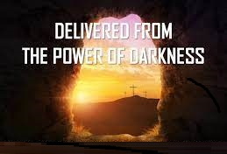
COLOSSIANS 1:3-14 THANKSGIVING AND PRAYER (Cond’t)
1.13 Who hath delivered us from the power of darkness, and hath translated us into the kingdom of his dear Son:
Paul is speaking of deliverance from darkness, which according to the Jewish people, is characterized by sin and ignorance. God rescues believers from the power of sin and its consequences (Romans 6:23). Believers are not protected from merely the penalty of sin,
9/28/2022
26
Notes:
Romans 6:23-For the wages of sin is death; but the gift of God is eternal life through Jesus Christ our Lord.

Slide 27
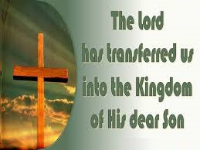
COLOSSIANS 1:3-14 THANKSGIVING AND PRAYER (Cond’t)
we are bound for eternity in Heaven.
9/28/2022
27
Notes:
Romans 6:23-

Slide 28
COLOSSIANS 1:3-14 THANKSGIVING AND PRAYER (Cond’t)
1.14 In whom we have redemption through his blood, even the forgiveness of sins:
This verse concludes Paul’s prayer with a reminder of what Jesus has done: He has provided redemption through His sacrifice. Forgiveness of sin is at the heart of the gospel message (Matthew 26:28). Hebrews 9:22 reminds us that "without the shedding of blood there is no forgiveness of sins." Christ's shed blood offers forgiveness to all who believe in Him.
9/28/2022
28
Notes:
Matthew 26:28-For this is my blood of the new testament, which is shed for many for the remission of sins.

Slide 29
COLOSSIANS 1:15-17 THE PREEMINENCE OF CHRIST IN CREATION
1.15 Who is the image of the invisible God, the firstborn of every creature:
Verse 15 begins a new section focusing on the supremacy of Jesus. Jesus, who is God the Son, is equal with God the Father (John 10:30). Jesus is God in human form, the visible image of the invisible God. The phrase "firstborn of every creature" refers to supremacy, or priority. Jesus is the greatest over all creation. He is not a created being; He is the Creator.
9/28/2022
29
Notes:
John 10:30-I and my Father are one.

Slide 30
COLOSSIANS 1:15-17 THE PREEMINENCE OF CHRIST IN CREATION (Cond’t)
1.16 For by him were all things created, that are in heaven, and that are in earth, visible and invisible, whether they be thrones, or dominions, or principalities, or powers: all things were created by him, and for him:
This verse shows the all-encompassing nature of Christ's creative power. It included absolutely everything imaginable: heaven, earth, visible, invisible. And, it included all living things in heaven, such as the angels and spiritual
9/28/2022
30

Slide 31
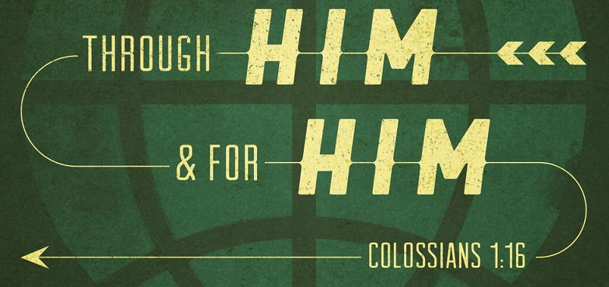
COLOSSIANS 1:15-17 THE PREEMINENCE OF CHRIST IN CREATION (Cond’t)
powers. Paul also adds all things were made by Jesus, and they were also created through Jesus, and for Jesus. Since Jesus is God, all of reality is the result of His own power. Creation exists for His glory (John 17:24).
9/28/2022
31
Notes:
John 17:24-Father, I will that they also, whom thou hast given me, be with me where I am; that they may behold my glory, which thou hast given me: for thou lovedst me before the foundation of the world.

Slide 32
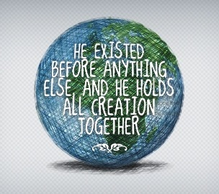
COLOSSIANS 1:15-17 THE PREEMINENCE OF CHRIST IN CREATION (Cond’t)
1.17 And he is before all things, and by him all things consist.
Here, Paul explains that Jesus existed prior to all other things. He is eternal, just like God the Father (John 1:1–3). Jesus is both creator and sustainer of our world. In one sense this verse summarizes Paul's words in the previous two verses on the supremacy of Christ.
9/28/2022
32
Notes:
John 1:1–3-In the beginning was the Word, and the Word was with God, and the Word was God.
2The same was in the beginning with God.
3All things were made by him; and without him was not any thing made that was made.

Slide 33
COLOSSIANS 1:18-23 THE PREEMINENCE OF CHRIST IN REDEMPTION
1.18 And he is the head of the body, the church: who is the beginning, the firstborn from the dead; that in all things he might have the preeminence.
Paul adds two additional qualities about Christ in this verse. First, He calls Jesus "the beginning." In fact, in Hebrew, the book of Genesis is called Bereshith, which is the first word of the text, and literally means "The Beginning." Second, Paul refers to Jesus as "the
9/28/2022
33

Slide 34
COLOSSIANS 1:18-23 THE PREEMINENCE OF CHRIST IN REDEMPTION (Cond’t)
firstborn from the dead," a reference to His resurrection. Because Jesus rose from the dead, He is "preeminent" the supreme in all things.
9/28/2022
34

Slide 35
COLOSSIANS 1:18-23 THE PREEMINENCE OF CHRIST IN REDEMPTION (Cond’t)
1.19 For it pleased the Father that in him should all fulness dwell;
This verse emphasizes the incarnation of Jesus in human form. Jesus' birth and His dwelling with man offered a personal connection to fulfill the prophecies of Messiah. Jesus Christ came to fulfill God’s saving plan.
9/28/2022
35

Slide 36
COLOSSIANS 1:18-23 THE PREEMINENCE OF CHRIST IN REDEMPTION (Cond’t)
1.20 And, having made peace through the blood of his cross, by him to reconcile all things unto himself; by him, I say, whether they be things in earth, or things in heaven.
The last verse of Paul's praise of Christ again emphasizes all that has taken place through Jesus. Through His death on the cross Jesus provided reconciliation in restoring men and the rest of creation to God. Paul uses the phrase "things in earth, or things in heaven" to show the
9/28/2022
36

Slide 37
COLOSSIANS 1:18-23 THE PREEMINENCE OF CHRIST IN REDEMPTION (Cond’t)
amazing extent to which God has provided for us.
9/28/2022
37

Slide 38
COLOSSIANS 1:18-23 THE PREEMINENCE OF CHRIST IN REDEMPTION (Cond’t)
1.21 And you, that were sometime alienated and enemies in your mind by wicked works, yet now hath he reconciled.
This verse is the first of three (Colossians 1:21–23) where Paul speaks directly to the Colossian Christians. Three traits of the Colossians' prior lives are revealed in this verse. First, as unbelievers, they were "alienated." In other words, they were separated from God and did not belong to His family. Second, they lacked
9/28/2022
38

Slide 39
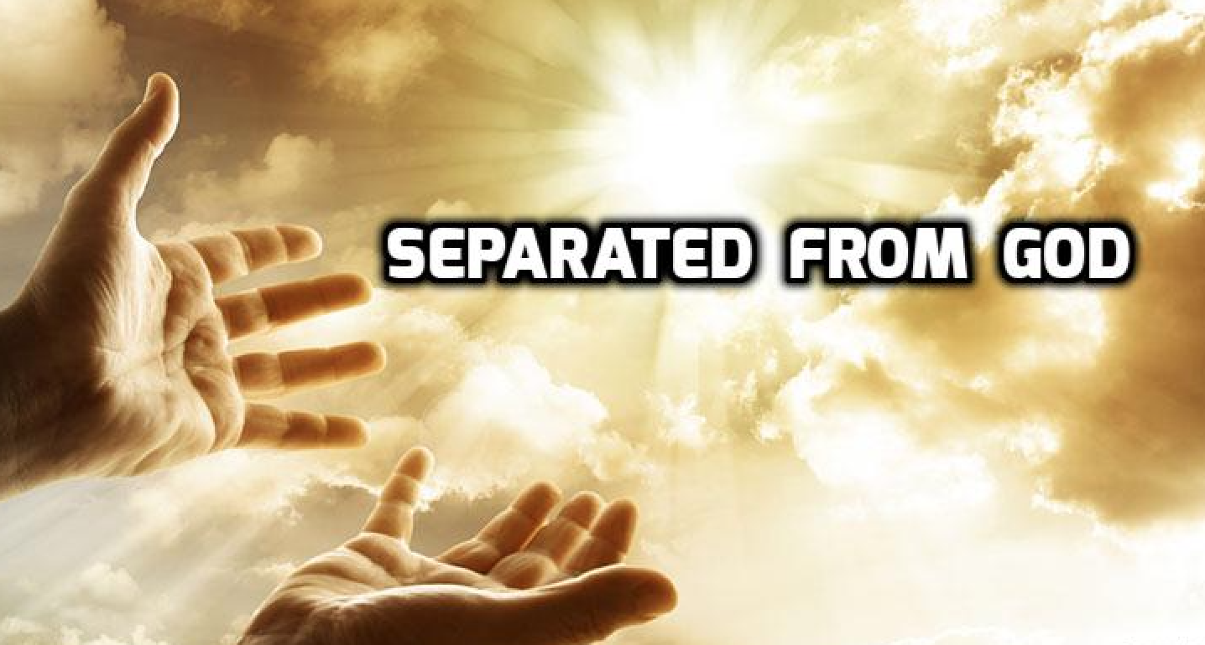
COLOSSIANS 1:18-23 THE PREEMINENCE OF CHRIST IN REDEMPTION (Cond’t)
knowledge of God, and in fact stood opposed to Him. Third, not belonging to God and opposing Him led to evil actions. This sinful condition stands as the backdrop of the message of hope Paul proclaims for their lives in the next verse.
9/28/2022
39

Slide 40
COLOSSIANS 1:18-23 THE PREEMINENCE OF CHRIST IN REDEMPTION (Cond’t)
1.22 In the body of his flesh through death, to present you holy and unblameable and unreproveable in his sight:
Paul emphasized the blood and the cross and the sacrificial act. Three reasons are given for Jesus to suffer and die. 1) Jesus died to present us” holy”, which means "set apart." We cannot be holy without His sacrifice on our behalf. 2) Jesus died so we could be blameless. While we will still sin in this life, His sacrifice provides
9/28/2022
40

Slide 41
COLOSSIANS 1:18-23 THE PREEMINENCE OF CHRIST IN REDEMPTION (Cond’t)
forgiveness of our sins (1 John 1:8–9). 3) Jesus died so we could be above reproach in an eternal sense, based on what Christ has done, not our human efforts. The sacrifice of Jesus makes us right with God, something only He can provide.
9/28/2022
41
Notes:
1 John 1:8–9-If we say that we have no sin, we deceive ourselves, and the truth is not in us.
9If we confess our sins, he is faithful and just to forgive us our sins, and to cleanse us from all unrighteousness.

Slide 42
COLOSSIANS 1:18-23 THE PREEMINENCE OF CHRIST IN REDEMPTION (Cond’t)
1.23 If ye continue in the faith grounded and settled, and be not moved away from the hope of the gospel, which ye have heard, and which was preached to every creature which is under heaven; whereof I Paul am made a minister;
In the beginning of the verse Paul gives four marks of legitimate believers, 1) continuing in the faith 2) being grounded(stable) 3) being settled(steadfast) 4) not moved away(shifting) from the hope of the gospel. The end of the
9/28/2022
42

Slide 43
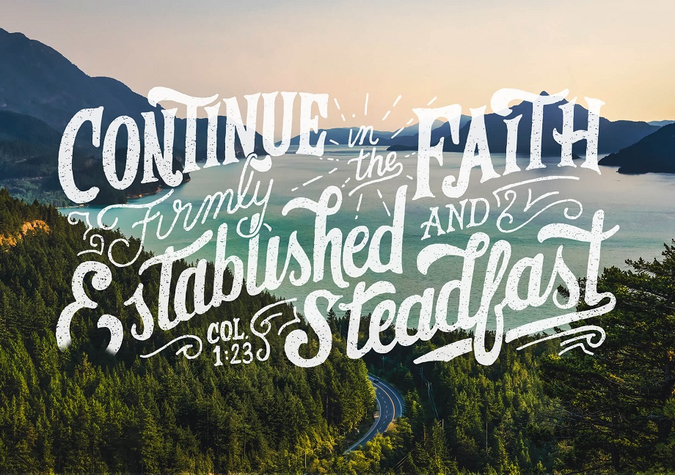
COLOSSIANS 1:18-23 THE PREEMINENCE OF CHRIST IN REDEMPTION (Cond’t)
verse notes two important concepts. Paul refers to the wide spread of the gospel message and states he is a minister of the gospel, to emphasize a servant of The Lord.
9/28/2022
43

Slide 44
COLOSSIANS 1:24-29 THE APOSTLE OF CHRIST PAUL'S SERVICE
1.24 Who now rejoice in my sufferings for you, and fill up that which is behind of the afflictions of Christ in my flesh for his body's sake, which is the church:
This verse emphasizes Paul's sufferings. Writing from Roman house arrest, he declares that he can still rejoice, even though he is under hardship. Paul considers his afflictions a service, one which Christ left for His followers to fulfill.
9/28/2022
44

Slide 45
COLOSSIANS 1:24-29 THE APOSTLE OF CHRIST PAUL'S SERVICE
9/28/2022
45

Slide 46
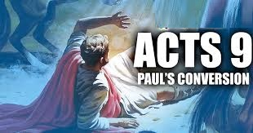
COLOSSIANS 1:24-29 THE APOSTLE OF CHRIST PAUL'S SERVICE (Cond’t)
1.25 Whereof I am made a minister, according to the dispensation of God which is given to me for you, to fulfil the word of God;
Here Paul refers to himself as a "minster," meaning a "servant" of the gospel and of the church. Paul viewed his work as part of God's plan for his life. It was not merely for his own benefit, but in order to serve and save others.
9/28/2022
46

Slide 47
COLOSSIANS 1:24-29 THE APOSTLE OF CHRIST PAUL'S SERVICE (Cond’t)
1.26 Even the mystery which hath been hid from ages and from generations, but now is made manifest to his saints:
Before Jesus came to earth, no one knew exactly how God planned to fulfill all of His many prophecies regarding the Jewish Messiah. Jesus revealed Himself to Paul on the road to Damascus, and the mystery was made known by revelation (Ephesians 3:3).
9/28/2022
47
Notes:
Ephesians 3:3-How that by revelation he made known unto me the mystery; (as I wrote afore in few words)

Slide 48
COLOSSIANS 1:24-29 THE APOSTLE OF CHRIST PAUL'S SERVICE (Cond’t)
1.27 To whom God would make known what is the riches of the glory of this mystery among the Gentiles; which is Christ in you, the hope of glory:
Paul is writing to Gentile converts, and the specific mystery that he is talking about here—our hope—is Christ in us. This mystery that Christ lives in all believers (Jews and Gentiles) is now revealed to the church. This applies directly to us because it is Christ living His life
9/28/2022
48

Slide 49
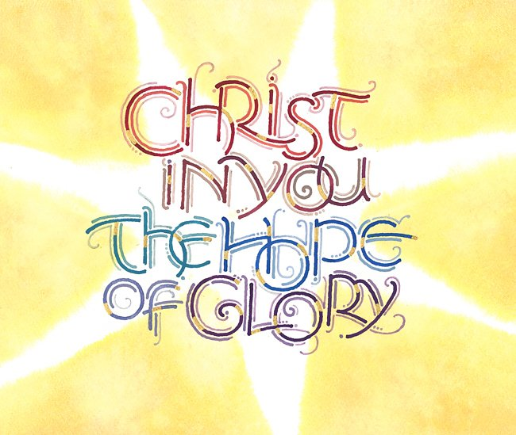
COLOSSIANS 1:24-29 THE APOSTLE OF CHRIST PAUL'S SERVICE (Cond’t)
in us that prepares us for the Kingdom of God.
9/28/2022
49

Slide 50
COLOSSIANS 1:24-29 THE APOSTLE OF CHRIST PAUL'S SERVICE (Cond’t)
1.28 Whom we preach, warning every man, and teaching every man in all wisdom; that we may present every man perfect in Christ Jesus:
The phase “Whom we preach” involves communicating to a large audience. Here, Paul notes he communicated Christ through "warning" or counseling - using the gospel and biblical teaching to help people with problem areas in their life. Paul also communicated through “teaching” or instruction, offering
9/28/2022
50

Slide 51
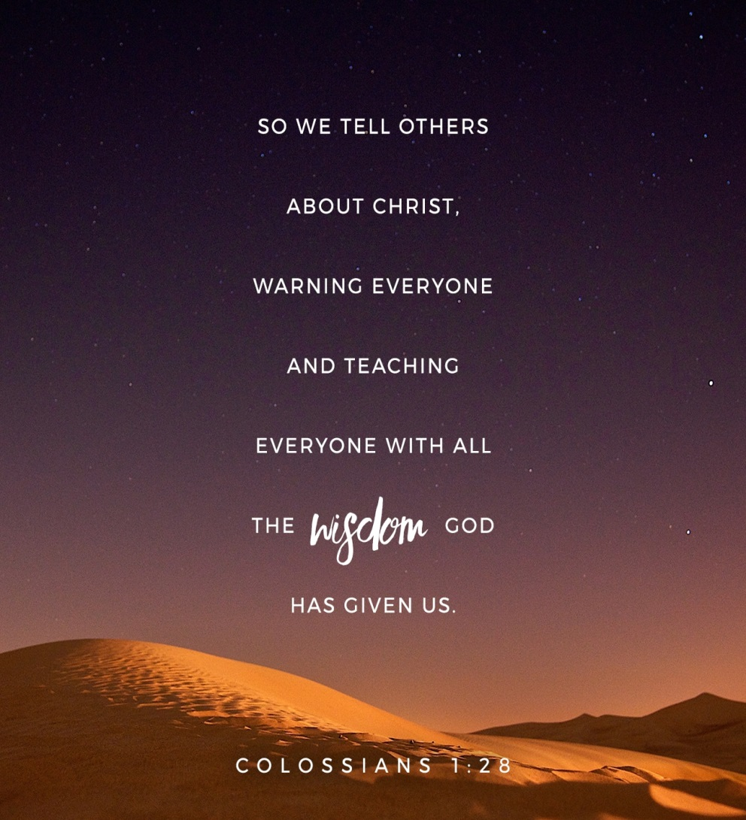
COLOSSIANS 1:24-29 THE APOSTLE OF CHRIST PAUL'S SERVICE (Cond’t)
Information to help others know the gospel. Last, Paul was not content of only converting people to Christ; he also desired maturity by equipping the saints for the work of the ministry.
9/28/2022
51

Slide 52
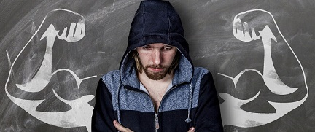
COLOSSIANS 1:24-29 THE APOSTLE OF CHRIST PAUL'S SERVICE (Cond’t)
1.29 Whereunto I also labour, striving according to his working, which worketh in me mightily.
Paul ends the chapter describing his work as a minister. He both toiled and struggled to care for the many believers he served. Yet he did not serve in his own human strength, God provided the power (Ephesians 2:8–9).
9/28/2022
52
Notes:
Ephesians 2:8–9-For by grace are ye saved through faith; and that not of yourselves: it is the gift of God:
9Not of works, lest any man should boast.

Slide 53
THIS CONCLUDES COLOSSIANS CHAPTER 1
9/28/2022
53

