Slide 1
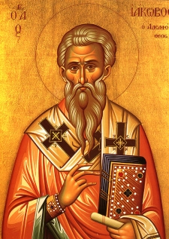
JAMES “THE JUST”

Slide 2
SUMMARY
James chapter 2 continues the theme of maturity presented chapter 1. James begins by challenging his readers to view trials as opportunities to grow rather than obstacles to lament. He asserts that every trial we overcome helps us mature as Christians. Enduring them makes our faith and relationship with our Savior all the stronger. This maturity leads us to put our faith into action, and James says we are blessed when we look into the perfect law of liberty and then do what we find there.
6/6/2022
2

Slide 3
2:1-13 TRUE RELIGION DOES NOT SHOW PARTIALITY
2.1 My brethren, have not the faith of our Lord Jesus Christ, the Lord of glory, with respect of persons.
James wrote the above to encourage the people under his care to cease practicing the faith in Jesus Christ with a spirit of personal favoritism. If we profess to follow Jesus, then we must view people in terms of what God sees - not in terms of worldly values.
6/6/2022
3

Slide 4
2:1-13 TRUE RELIGION DOES NOT SHOW PARTIALITY (con’t)
2.2 For if there come unto your assembly a man with a gold ring, in goodly apparel, and there come in also a poor man in vile raiment; 2.3 And ye have respect to him that weareth the gay clothing, and say unto him, Sit thou here in a good place; and say to the poor, Stand thou there, or sit here under my footstool:
2.4 Are ye not then partial in yourselves, and are become judges of evil thoughts?
6/6/2022
4

Slide 5
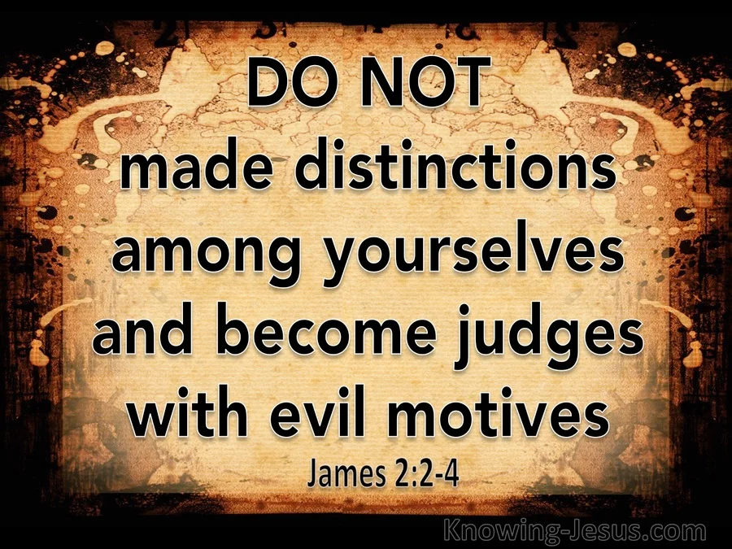
2:1-13 TRUE RELIGION DOES NOT SHOW PARTIALITY (con’t)
James says that his readers had become "judges with evil thoughts". It may have been that they wanted to look good, or to have a big donator in their church. But the point is that we are operating from sinful motives whenever we neglect someone Jesus loves in preference for outward standards.
6/6/2022
5

Slide 6
2:1-13 TRUE RELIGION DOES NOT SHOW PARTIALITY (con’t)
2.5 Hearken, my beloved brethren, Hath not God chosen the poor of this world rich in faith, and heirs of the kingdom which he hath promised to them that love him?
2.6a But ye have despised the poor…
Jesus did choose the foolish and weak things of this world in order to shame the wise and powerful (1 Cor. 1:26-31) How wrong it is, then, to instead dishonor that one that Jesus honors!
6/6/2022
6
Notes:
1 Cor. 1:26-31 - For ye see your calling, brethren, how that not many wise men after the flesh, not many mighty, not many noble, are called:
27But God hath chosen the foolish things of the world to confound the wise; and God hath chosen the weak things of the world to confound the things which are mighty;
28And base things of the world, and things which are despised, hath God chosen, yea, and things which are not, to bring to nought things that are:
29That no flesh should glory in his presence.
30But of him are ye in Christ Jesus, who of God is made unto us wisdom, and righteousness, and sanctification, and redemption:
31That, according as it is written, He that glorieth, let him glory in the Lord.

Slide 7
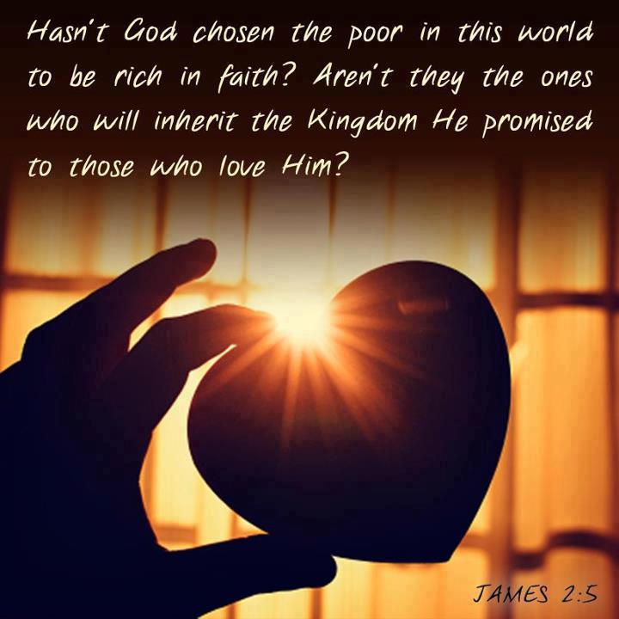
2:1-13 TRUE RELIGION DOES NOT SHOW PARTIALITY (con’t)
6/6/2022
7

Slide 8
2:1-13 TRUE RELIGION DOES NOT SHOW PARTIALITY (con’t)
2.6b… Do not rich men oppress you, and draw you before the judgment seats?
Likewise, how wrong it is to honor those who dishonor Christ! James is not saying here that it's wrong to be rich. The rich that he is speaking of here were obviously very sinful and wicked, and were described by him in James 5:1-6.
6/6/2022
8
Notes:
James 5:1-6 - Go to now, ye rich men, weep and howl for your miseries that shall come upon you.
2Your riches are corrupted, and your garments are motheaten.
3Your gold and silver is cankered; and the rust of them shall be a witness against you, and shall eat your flesh as it were fire. Ye have heaped treasure together for the last days.
4Behold, the hire of the labourers who have reaped down your fields, which is of you kept back by fraud, crieth: and the cries of them which have reaped are entered into the ears of the Lord of sabaoth.
5Ye have lived in pleasure on the earth, and been wanton; ye have nourished your hearts, as in a day of slaughter.
6Ye have condemned and killed the just; and he doth not resist you.

Slide 9
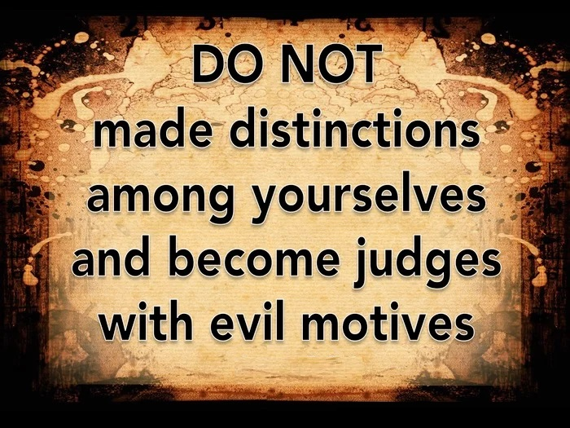
2:1-13 TRUE RELIGION DOES NOT SHOW PARTIALITY (con’t)
2.7 Do not they blaspheme that worthy name by the which ye are called?
We should never again judge one another on the basis of earthly riches, or ever again look down our noses who have little of this world's goods. Instead, we should glorify God who showered such grace on those He has called.
6/6/2022
9

Slide 10
2:1-13 TRUE RELIGION DOES NOT SHOW PARTIALITY (con’t)
2.8 If ye fulfil the royal law according to the scripture, Thou shalt love thy neighbour as thyself, ye do well:
The standard of treating each other correctly is found in Leviticus 19:15-18; especially verse 18. "... You shall love your neighbor as yourself ..." We often hear this called "the golden rule.“ James says we do well if we fulfill it.
6/6/2022
10
Notes:
Leviticus 19:15-18 - Ye shall do no unrighteousness in judgment: thou shalt not respect the person of the poor, nor honour the person of the mighty: but in righteousness shalt thou judge thy neighbour.
16Thou shalt not go up and down as a talebearer among thy people: neither shalt thou stand against the blood of thy neighbour: I am the LORD.
17Thou shalt not hate thy brother in thine heart: thou shalt in any wise rebuke thy neighbour, and not suffer sin upon him.
18Thou shalt not avenge, nor bear any grudge against the children of thy people, but thou shalt love thy neighbour as thyself: I am the LORD.

Slide 11
2:1-13 TRUE RELIGION DOES NOT SHOW PARTIALITY (con’t)
2.9 But if ye have respect to persons, ye commit sin, and are convinced of the law as transgressors.
James is saying if we are showing partiality (as he described it in verses 1-7), then we sin. This may surprise us. After all, it's a pretty natural condition among people - seeing as how we're naturally drawn to those who are beautiful, or talented, or intelligent, or wealthy.
6/6/2022
11

Slide 12
2:1-13 TRUE RELIGION DOES NOT SHOW PARTIALITY (con’t)
2.10 For whosoever shall keep the whole law, and yet offend in one point, he is guilty of all.
In this section James says there is the principle of "the unity of God's law." God's law is not a set of disconnected commandments; but rather a unified whole. If we keep nine of His ten commandments, and yet break one, we stand as guilty a lawbreaker before God as if we had broken all of them.
6/6/2022
12

Slide 13
2:1-13 TRUE RELIGION DOES NOT SHOW PARTIALITY (con’t)
2.11 For he that said, Do not commit adultery, said also, Do not kill. Now if thou commit no adultery, yet if thou kill, thou art become a transgressor of the law.
Jesus teaches us that murder includes the idea of "diminishing" someone in any way or reducing their value (Matthew 5:21-22). We're therefore guilty of murder all the time; and are, just as much a lawbreaker as if we had committed adultery.
6/6/2022
13
Notes:
Matthew 5:21-22 - Ye have heard that it was said by them of old time, Thou shalt not kill; and whosoever shall kill shall be in danger of the judgment:
22But I say unto you, That whosoever is angry with his brother without a cause shall be in danger of the judgment: and whosoever shall say to his brother, Raca, shall be in danger of the council: but whosoever shall say, Thou fool, shall be in danger of hell fire.

Slide 14
2:1-13 TRUE RELIGION DOES NOT SHOW PARTIALITY (con’t)
2.12 So speak ye, and so do, as they that shall be judged by the law of liberty.
The “law of liberty" (James 1:25) means that, when we look into the law, (1) we see that we are sinners, (2) we flee to the cross of Jesus for forgiveness, and (3) by God's grace, we are pardoned of our guilt and set at liberty (Gal. 3:24; John 8:36). We are to so act and so speak as those who hope to be judged by God's law in such a way as for it to be a "law of liberty"
6/6/2022
14
Notes:
James 1:25 - But whoso looketh into the perfect law of liberty, and continueth therein, he being not a forgetful hearer, but a doer of the work, this man shall be blessed in his deed.
Gal. 3:24 - Wherefore the law was our schoolmaster to bring us unto Christ, that we might be justified by faith.
John 8:36 - If the Son therefore shall make you free, ye shall be free indeed.

Slide 15
2:1-13 TRUE RELIGION DOES NOT SHOW PARTIALITY (con’t)
to us. We are to do unto others as we would have done unto us.
6/6/2022
15

Slide 16
2:1-13 TRUE RELIGION DOES NOT SHOW PARTIALITY (con’t)
2.13 For he shall have judgment without mercy, that hath shewed no mercy; and mercy rejoiceth against judgment.
The effect of this is to make guilty sinners out of all of us (Rom. 3:19-20). If then, we are all equally sinners before God, then we are all equally in need of God's grace and mercy. We hope God's mercy will be shown to us. It would follow, then, that we should show the same thing toward one another as we would
6/6/2022
16
Notes:
Rom. 3:19-20 - Now we know that what things soever the law saith, it saith to them who are under the law: that every mouth may be stopped, and all the world may become guilty before God.
20Therefore by the deeds of the law there shall no flesh be justified in his sight: for by the law is the knowledge of sin.

Slide 17
2:1-13 TRUE RELIGION DOES NOT SHOW PARTIALITY (con’t)
hope to be shown toward us. James also encourages us by reminding us that mercy always triumphs over judgment.
6/6/2022
17

Slide 18
2:14-26 TRUE RELIGION SHOWS FAITH THROUGH WORKS
2.14 What doth it profit, my brethren, though a man say he hath faith, and have not works? can faith save him?
James asks what profit it is if someone claims to have saving faith, but has none of the fruits in the form of good works that such saving faith should produce.
6/6/2022
18

Slide 19
2:14-26 TRUE RELIGION SHOWS FAITH THROUGH WORKS (Cond’t)
James says that such a faith is of no value. It may be like the tree - impressive to look at; but it will be of no value in the thing it was supposed to accomplish.
6/6/2022
19

Slide 20
2:14-26 TRUE RELIGION SHOWS FAITH THROUGH WORKS (con’t)
2.15 If a brother or sister be naked, and destitute of daily food,
2.16 And one of you say unto them, Depart in peace, be ye warmed and filled; notwithstanding ye give them not those things which are needful to the body; what doth it profit?
2.17 Even so faith, if it hath not works, is dead, being alone.
6/6/2022
20

Slide 21
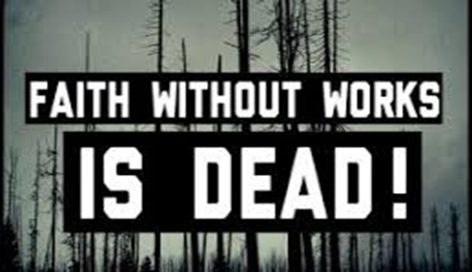
2:14-26 TRUE RELIGION SHOWS FAITH THROUGH WORKS (con’t)
James says, faith without works is "dead" (that is, inoperative). Words of blessing without acts of love are dead; and faith that doesn't have works is also dead. It doesn't do what it is proposed to do - that is, bring about salvation.
6/6/2022
21

Slide 22
2:14-26 TRUE RELIGION SHOWS FAITH THROUGH WORKS (con’t)
2.18 Yea, a man may say, Thou hast faith, and I have works: shew me thy faith without thy works, and I will shew thee my faith by my works.
James now sums up and explains someone who never says that they have faith can demonstrate that they really do have faith. How by the fact that they have works that accompany faith. If a man were to boast, "I have faith", but didn't have works, he would
6/6/2022
22

Slide 23
2:14-26 TRUE RELIGION SHOWS FAITH THROUGH WORKS (con’t)
be at the mercy of a man who never boasted faith at all, but shows the presence of faith through his works.
6/6/2022
23

Slide 24
2:14-26 TRUE RELIGION SHOWS FAITH THROUGH WORKS (con’t)
2.19 Thou believest that there is one God; thou doest well: the devils also believe, and tremble.
Believing that there is one God puts you at no advantage. James says, "You do well" - but much more is needed. To believe that there is one God places you at no greater advantage than the demons. They believe too - and they have even seen the one true God, and tremble at the thought - but that doesn't save them.
6/6/2022
24

Slide 25
2:14-26 TRUE RELIGION SHOWS FAITH THROUGH WORKS (con’t)
2.20 But wilt thou know, O vain man, that faith without works is dead?
2.21 Was not Abraham our father justified by works, when he had offered Isaac his son upon the altar?
2.22 Seest thou how faith wrought with his works, and by works was faith made perfect? 2.23 And the scripture was fulfilled which saith, Abraham believed God, and it was imputed unto him for righteousness: and he was called the Friend of God.
6/6/2022
25

Slide 26
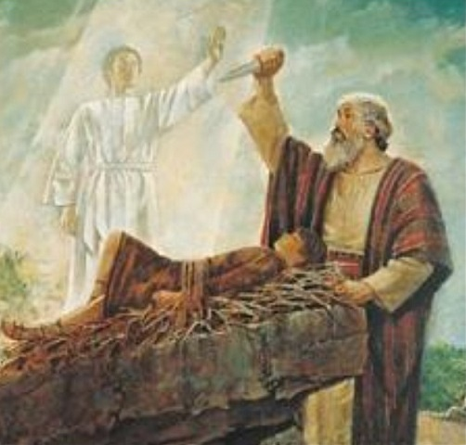
2:14-26 TRUE RELIGION SHOWS FAITH THROUGH WORKS (con’t)
2.24 Ye see then how that by works a man is justified, and not by faith only.
Abraham proved this faith by works when God commanded Abraham to take his promised son Isaac, to a certain place and sacrifice him (Gen. 22:2).
6/6/2022
26
Notes:
Gen. 22:2 - And he said, Take now thy son, thine only son Isaac, whom thou lovest, and get thee into the land of Moriah; and offer him there for a burnt offering upon one of the mountains which I will tell thee of.

Slide 27
2:14-26 TRUE RELIGION SHOWS FAITH THROUGH WORKS (Cond’t)
Abraham obeyed; though it was a test, and God later stopped him (Gen. 22:12). Abraham trusted that God could even raise the dead (Heb. 11:19). Thus, Abraham was justified by works; and his faith was thus "perfected".
6/6/2022
27
Notes:
Gen. 22:12 - And he said, Lay not thine hand upon the lad, neither do thou any thing unto him: for now I know that thou fearest God, seeing thou hast not withheld thy son, thine only son from me.
Heb. 11:19 - Accounting that God was able to raise him up, even from the dead; from whence also he received him in a figure.

Slide 28
2:14-26 TRUE RELIGION SHOWS FAITH THROUGH WORKS (con’t)
2.25 Likewise also was not Rahab the harlot justified by works, when she had received the messengers, and had sent them out another way?
2.26 For as the body without the spirit is dead, so faith without works is dead also.
Rahab had faith in the one true God; but hers was a faith that demonstrated itself in works. She is an example of how saving faith demonstrates itself in good deeds. She had
6/6/2022
28

Slide 29
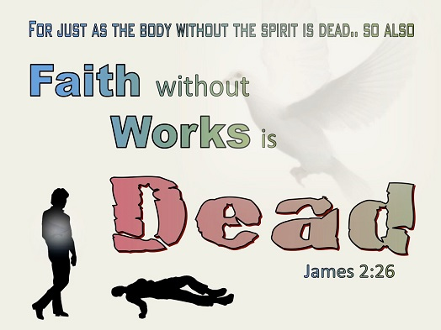
2:14-26 TRUE RELIGION SHOWS FAITH THROUGH WORKS (con’t)
faith in the God of Israel; and proved it by hiding the spies. God honored her faith, and made her a member of the linage of those from whom the Lord Jesus was to born (Matthew 1:5). She stands today as proof of the essential nature of works; that faith with out works is as dead as a body without a spirit.
6/6/2022
29
Notes:
Matthew 1:5 - And Salmon begat Booz of Rachab; and Booz begat Obed of Ruth; and Obed begat Jesse;

Slide 30
THIS CONCLUDES JAMES 2

